Slide 1

2Ring Dashboards
& Wallboards ..
Real-Time Reporting & Alerting for Five9
Follow Us on X: @2RingCX
Learn More: 2Ring.com/Five9

Slide 2
About 2Ring ..
Founded in 2001
Global Presence / Customer Base
European HQ in Slovakia
North America HQ in Sacramento, CA
ISV Partner with Five9® , Amazon, Calabrio®, CXone®, Cisco®, Genesys™ , Microsoft, ServiceNow™, ..

Slide 3
Business Case for 2Ring Dashboards & Wallboards ..
Deliver Data to Where your Users are
  Compatible with all major browsers
  Keyboard less secure sign-in on TVs or signage devices
  Display a personalized layout next to Salesforce UI (split tab feature in MS Edge), or make a layout float on top of all the application windows (2Ring Power Tool)
  Embed layouts to a channel in Microsoft Teams or into a space in Webex (bring real-time visibility to users who are not part of the contact center)
  Include a link to a specific layout with any of your real-time alerts (delivered via email, text, or to your IM client)
Merge Multiple Data Sources
  Show ServiceNow Data next to Five9 data
Massage Data with Ease (slick & easy to use)
  Break-down stats for different skill-groups, sites, ..
  Merge data for multiple queues / skill groups into one row / KPI
  Create your own CUSTOM calculations using derived metrics
  Create floor plans by leveraging powerful widgets
Encourage Competition Among Teams and Agents
  Upload personalized targets for agents or teams (csv import)
  Showcase best performers – e.g. top agents or teams
  Use calendars to visualize how well, or how often a goal was met
  Show trends – e.g. # of calls handled over the last 4 weeks
  Send encouraging messages to a scrolling text marquee

Slide 4
Procurement .. Purchasing 2Ring DW
2Ring Dashboards & Wallboards (2Ring DW) is available via many major resellers worldwide, and also via one-off agreements via Five9.
Step 1
Step 2
Step 3
PID | Description
2RING-SAAS | 2Ring Cloud Subscription
2RC-DW-F9 | 2Ring DW – Five9 Connector – per concurrent agent/supervisor
2RC-DW-F9-3Y | 2Ring DW – Five9 Connector – per concurrent agent/supervisor – 3-Year Prepaid Cloud Subscription
2RC-DW-F9-CRD | 2Ring DW – Five9 Connector – per conc agent/supervisor – migration
2RC-DW-F9-3Y-CRD | 2Ring DW – Five9 Connector – per concurrent agent/supervisor – 3-Year Prepaid Subscription - migration
2RING-1TF | One-Time Activation Fee
2RC-SERVICES | Setup, and training - CLOUD
2Ring Cloud (2Ring-SaaS)
New Customer
or
Existing 2Ring Customer moving to Five9
  Identify
  Number of Concurrent Agents (min 10) and initial term (min 12-months)
How to Consume 2Ring Service
2Ring Cloud Subscription (SaaS), terms are at www.2Ring.com/LegalCloud
Public Demo Cloud
Request access at www.2Ring.com/DWFive9Trial
Resellers, to get your own Business Unit (so you could control who gets access to layouts that you create), please contact us.
Instant Sample Layout
No login required, www.2Ring.com/TryItFive9

Slide 5
Support, Delivery, and Customer Success with 2Ring ..
2Ring offers an exceptional onboarding experience:
Delivery Timeline for 2Ring DW
Orders held released once basic information gets confirmed
Tenant available in 2-3 business days
Custom layouts and credentials shared with Admin shortly thereafter
Training videos on YouTube + a Webex Training Session with 2Ring Trainer available per request
2Ring Cloud SLA
24x7 Customer Support:
  Avg. response time <1 hour
Committed Initial Response:
  Severity 1: less than 4 hours
  Severity 2: less than 12 hours
  Severity 3: less than 72 hours
  Severity 4: less than 96 hours
Ensuring Customer Satisfaction
We train and equip customers to confidently adjust layouts and alerts on their own
Encourage feedback from customers and resellers to improve our offering
Our NPS is continuously over 90
Delivery Timeline
1st Week
2nd Week
3rd Week
4th Week
And beyond ..
Collect Initial Requirements
Tenant Creation + User Access
Finetune Layouts, Alerts, Themes
Training Videos + Session
24x7 Support from 2Ring ..

Slide 6

Customer Win: VSP Vision
“2Ring has provided us with a solution that more than meets our business needs. Providing customizable live metrics and alerting capabilities has given us the visibility we need to effectively manage our call centers. The 2Ring support and development team have been amazing partners throughout the stand-up process and beyond.”
Cody Pena, Business Technical Analyst

Slide 7

Customer Win: Credit Union of Colorado
“2Ring has offered us unparalleled insights into call volume and agent activity which has allowed our contact center to make informed decisions. We have expanded this to beyond our contact center into other departments such as our lending department and collections department, which has positively impacted our entire credit union.”
Morgan Petterson, Manager

Slide 8
Proven by Hundreds of Customers Worldwide ..
2Ring has revolutionized our ability to easily communicate key metrics to our entire organization. It has proven to be a versatile tool that can easily tie back to data from our latest generation phone system as well as our legacy systems. Overall, we are extremely happy with its functionality and ease of use.
The support team have always been quick to assist with the task and followed up until resolution. They have also assisted me in learning a little bit with each ticket so I can eventually be self-sufficient. A big kudos to the technical support team.
.. our supervisors are often pulled in multiple directions at the same time. The 2Ring solution has given them greater visibility and therefore control over our queues and agent management.
When we first started looking for a real time reporting wallboard application, we had a fundamental requirement. The selected solution needed to provide meaningful live data to support our self-management efforts and track our KPI performance. In addition, the selected platform had to be supportable by our contact center team with little to no effort/support and/or burden on our IT/IS team. I’m happy to report that after several months of utilization we can say proudly that we selected the correct solution. If you want a top performing tool supported by a great team, 2Ring is the correct choice for your organization.
Our 2Ring solution is providing much needed visibility for both our affected employees and management. Seeing real-time queue and agent status has contributed to more awareness around the organization’s ability to handle incoming patient calls to appointment schedulers and business office representatives.
The service we have received from 2Ring has been great, they don't let go until a problem is resolved and you understand what happened. I would suggest their products and services to any HealthCare organization in the world.
We needed a true wallboard solution for our Contact Center. We needed an application that would not only allow for real-time statistics but would make the actual day to day management of the tool user friendly. We vetted multiple vendors, went through multiple demos, and ultimately landed on 2Ring. The combination of cost, licensing model, familiarity with the product name and ease of implementation all factored in our informed decision-making process. While the IT Department had a technical opinion, the ultimate decision was made by our Contact Center team who ultimately approved due to 2Ring’s appealing layout and the ease of use of the product itself.
2Ring wallboard solution has provided a effective and efficient way to give us a visibility of our Call Center statistics. It also elegantly presents to our colleagues on what is being achieved by the Call Center.
Using 2Ring in our contact center helps our representatives make better decisions to assist customers more efficiently. Those that handle other functions aside from incoming call volume no longer need to wait for a manager to tell them to hop on to assist in our queues. They can make these decisions on their own which helps us not only create better experiences for our customers, but also empowers our representatives to be more efficient adding to their satisfaction.
2Ring has offered us unparalleled insights into call volume and agent activity which has allowed our contact center to make informed decisions. We have expanded this to beyond our contact center into other departments such as our lending department and collections department, which has positively impacted our entire organization.
I’ve been extremely pleased with the ease of configuration of 2Ring Dashboards & Wallboards. We examined many wallboard packages, and spoke to several different vendors during research, but 2Ring was head and shoulders above the rest in presenting a professional looking Wallboard that can be set up and modified with very little training necessary.
With the 2Ring dashboard we have been able to get the real time visibility we need to manage our call center. Each team member is able to see what the other one is doing, and we are able to coordinate our activities and minimize gaps in coverage. It’s been especially nice to have the flexibility to have different views for different skill sets, and control over the color coding and visuals of the KPI’s
Our 2Ring solution has dramatically reduced our SLO violations by bringing a much-needed visibility into agent status and capacity. The ROI on this product is almost immediate, within weeks we were consistently able to keep our SLO violations below thresholds. Having real time visibility of agent status and capacity of agents that those agents can view, minimizes management overhead, allows agents to capacity plan on the fly, and results in more client calls getting answered faster.
As the Call Center is not located in our corporate office, I monitor the Wallboards remotely from an iPad at my desk, which provides real-time visibility of call volumes and hold times. I really can’t recommend this software enough for its ease of use and real-time visibility.
.. a great addition to our Contact Center. It has given us many new capabilities that have increased our productivity and helped us serve our customers more efficiently.
I have been using the 2Ring Wallboard product for about 6 months now and I have been impressed with its ease of use – after about 8 hours of working with it I feel comfortable that I can create pretty much anything I want to create.
2Ring allows us to present call data to managers and executive staff in real-time on their desktop, monitors and other devices without the necessity of creating accounts in Cisco, consuming licenses or training users. The application is easy to customize for individual business units so they can view the information that is important to their operations.
Whenever we need work done by 2Ring your team has come through and in a very timely manner always willing to make changes quickly and effortlessly.

Slide 9
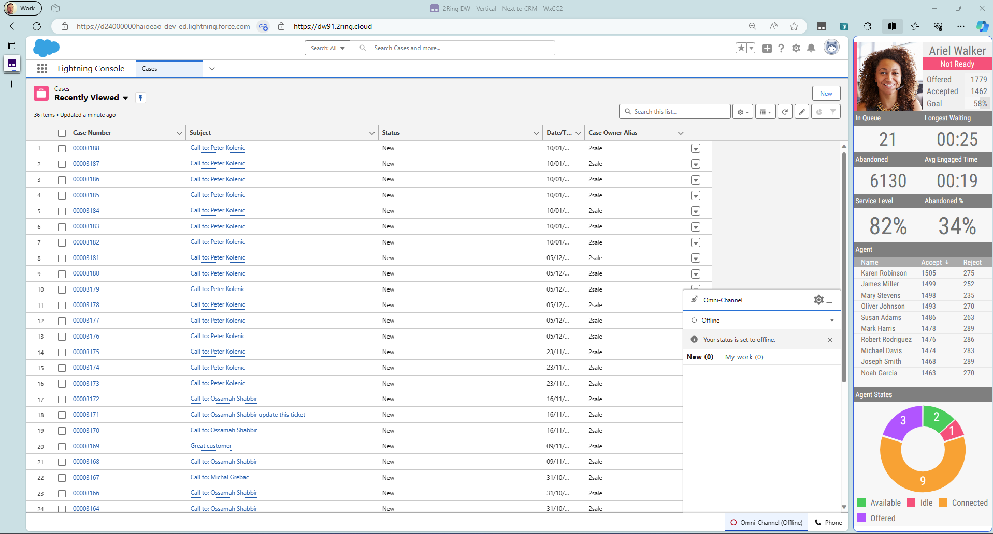
MS Edge: Personalized Layout Next to the CRM ..
Notes:
Note: It doesn’t have to be your CRM. It can be the Five9 agent desktop or any web-based application of your choosing.

Slide 10
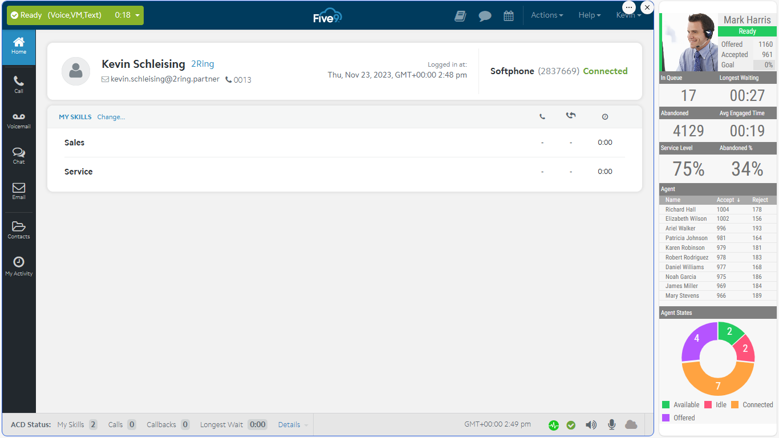
MS Edge: Personalized Layout Alongside the Agent Desktop ..

Slide 11
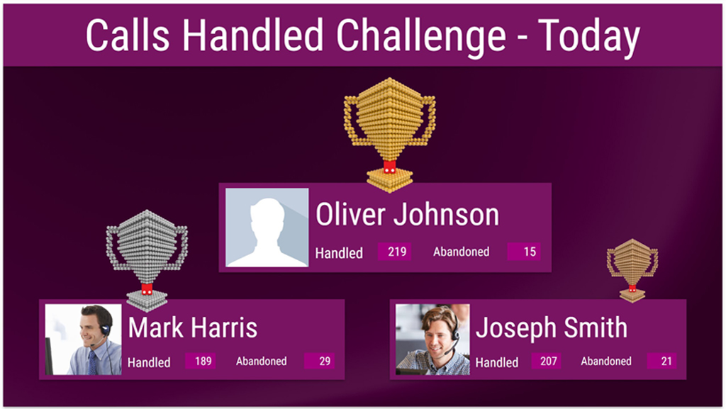
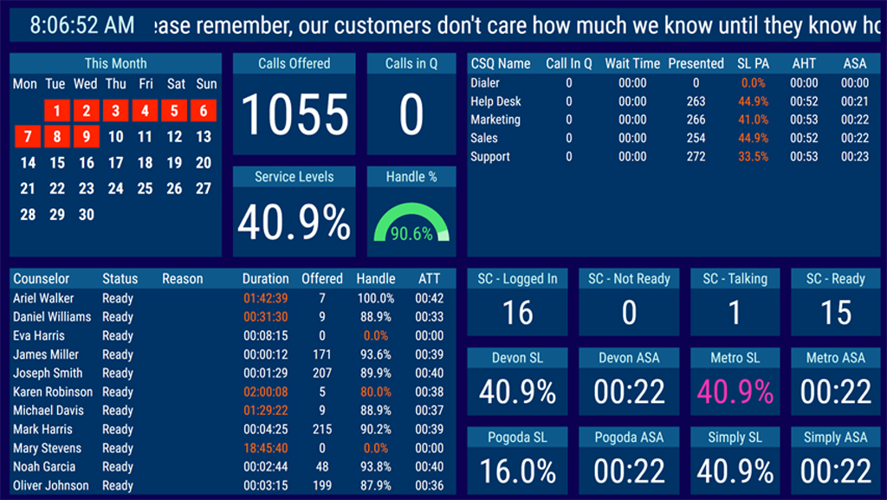
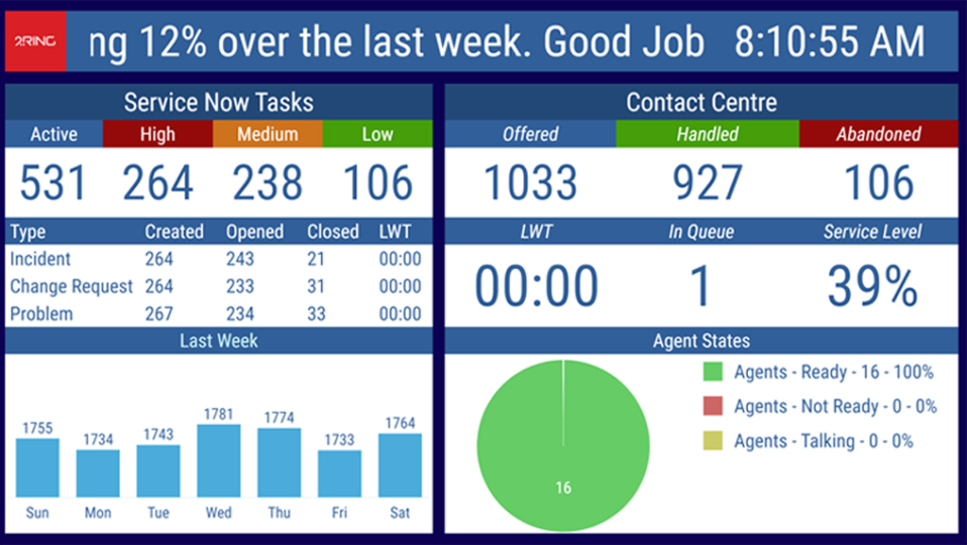
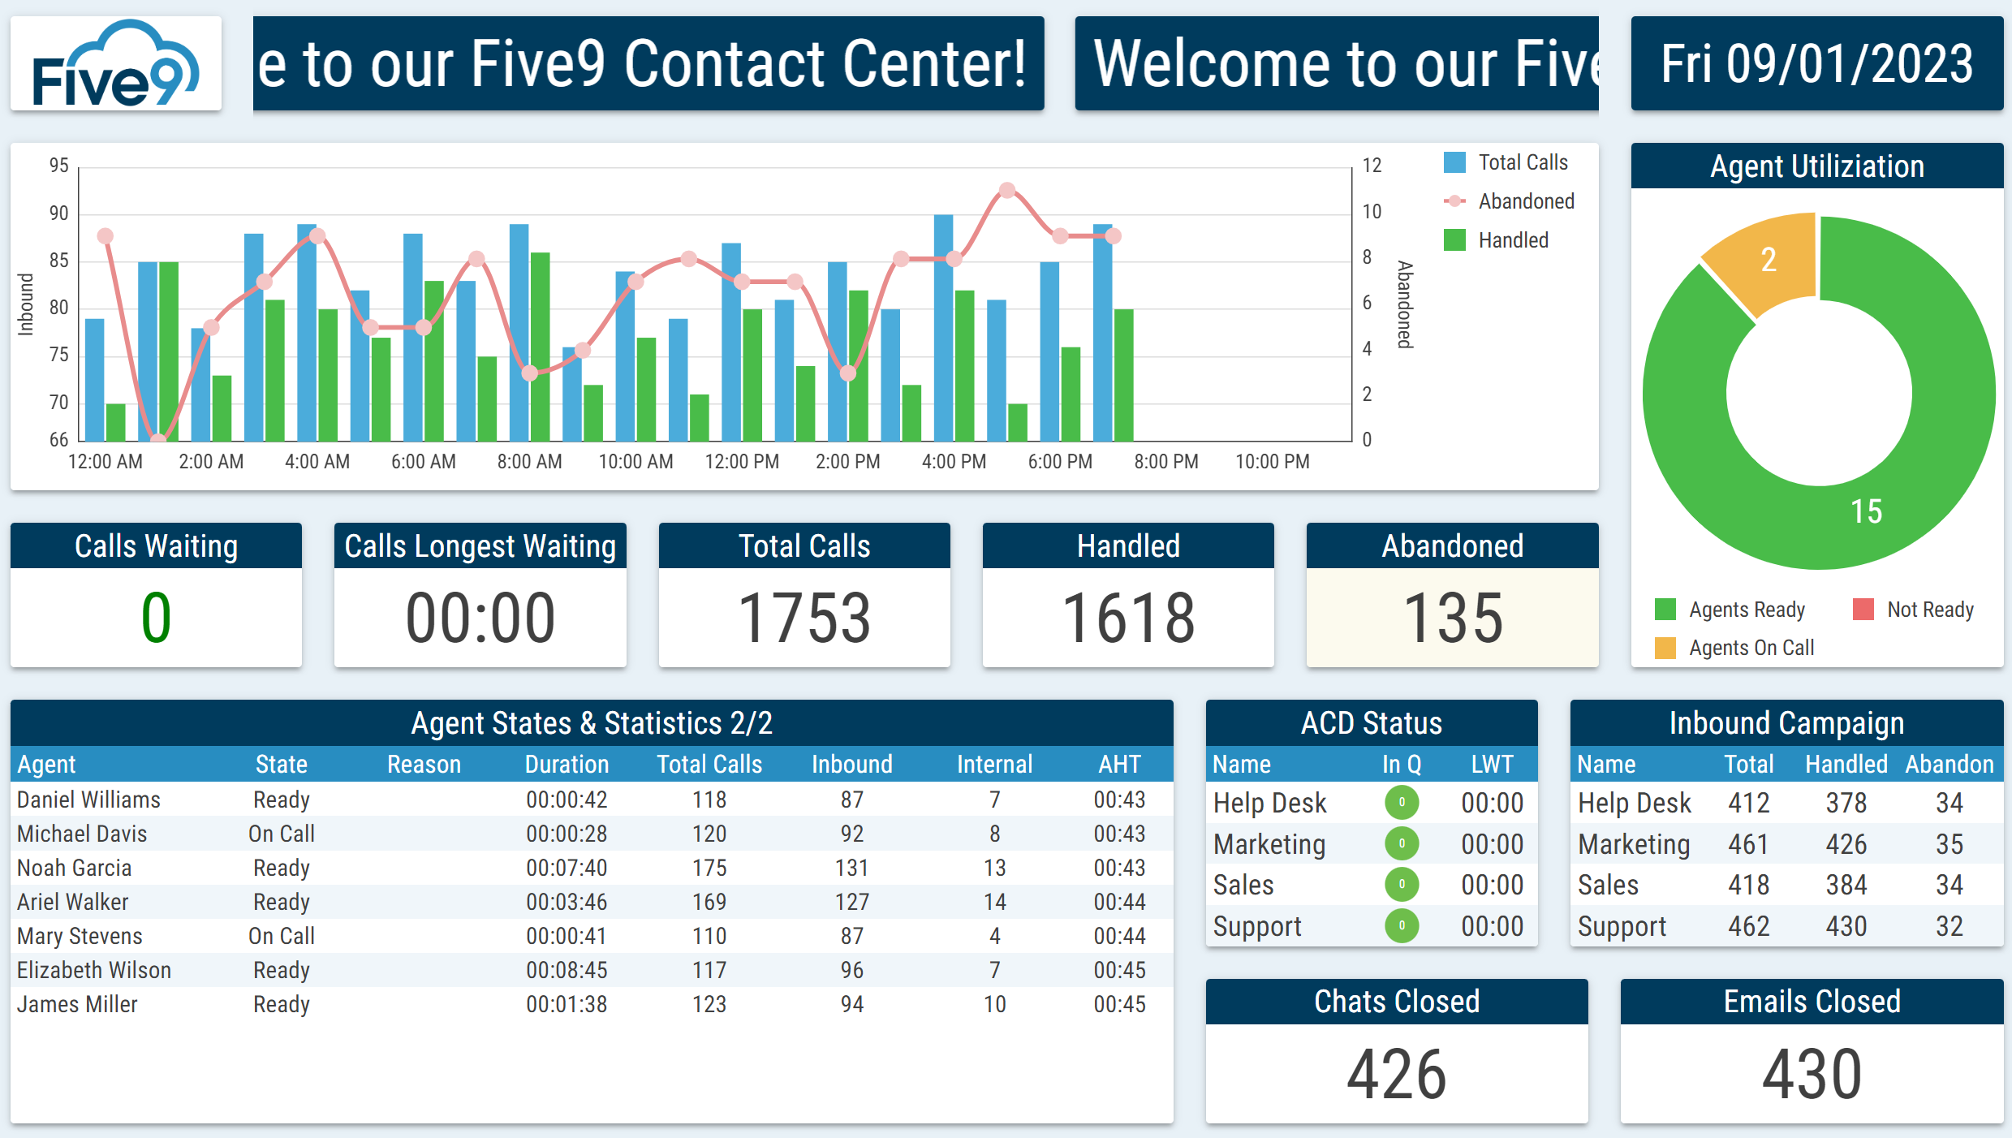
Deliver Eye-Catching & Flexible Layouts ..

Slide 12
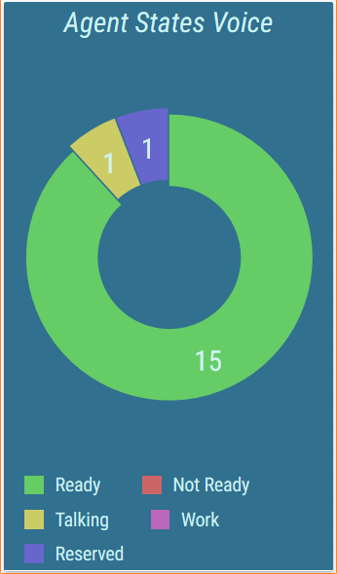
Real-Time Reporting Friendly to Business Users ..
A Web-Based Layout Editor
FULL control over every segment
  All options available via context menus on the right
  Changes shown immediately in the layout’s preview on the left
Layout Parameters: create a single layout to deliver thousands of personalized views to your agents
Layout can define parameters that are inherited by all KPIs, grids, charts, etc. When the value of the parameter changes on the layout, all child sources reflect it automatically.

Slide 13
Let’s make a few things clear ..
Public Demo Cloud
  Request access at 2Ring.com/DWFive9Trial
  To get your own Business Unit (so you could control who gets access to layouts that you create), please contact us.
Instant Sample Layout
  No login required 2Ring.com/TryItFive9
How to Consume 2Ring Service
  2Ring Cloud Subscription (SaaS)
  2Ring Terms are available at 2Ring.com/LegalCloud
  Licensed by number of Concurrent Agents (min 10) and initial term (min. 12-months)
  Onetime activation fee includes creation of an initial set of custom layouts (up to 10) and a training session as well.

Slide 14
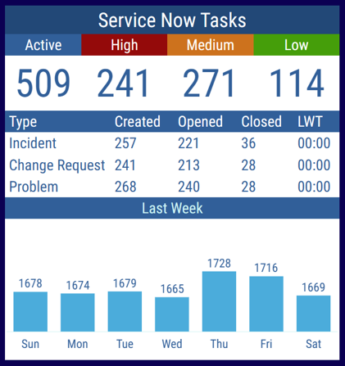
Use Multiple Data Sources ..
Include additional business
relevant information from cloud-based data sources, such as
ServiceNow
A grid can be composed of multiple tables. Combine multiple tables from the same or even from different connectors (a grid can be composed of multiple tables, e.g. a single grid displays stats from a call center, and a ticketing system).
Build a unique layout for each department – e.g. service desk: 2Ring.com/TryItServiceNow

Slide 15
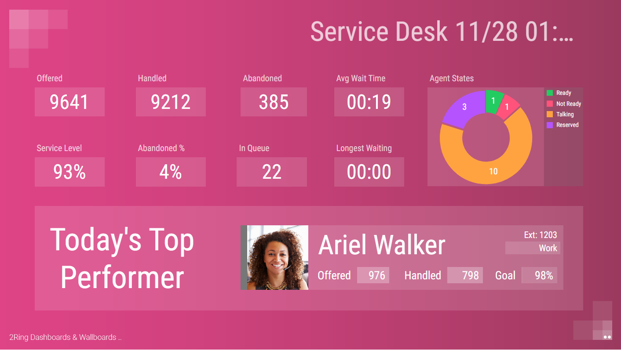
Media Content: Import media files to enrich your layouts ..
Use agent photos to personify agent stats
Play video, presentations, PDF files
Play audible alerts in reaction to key events in contact center

Slide 16
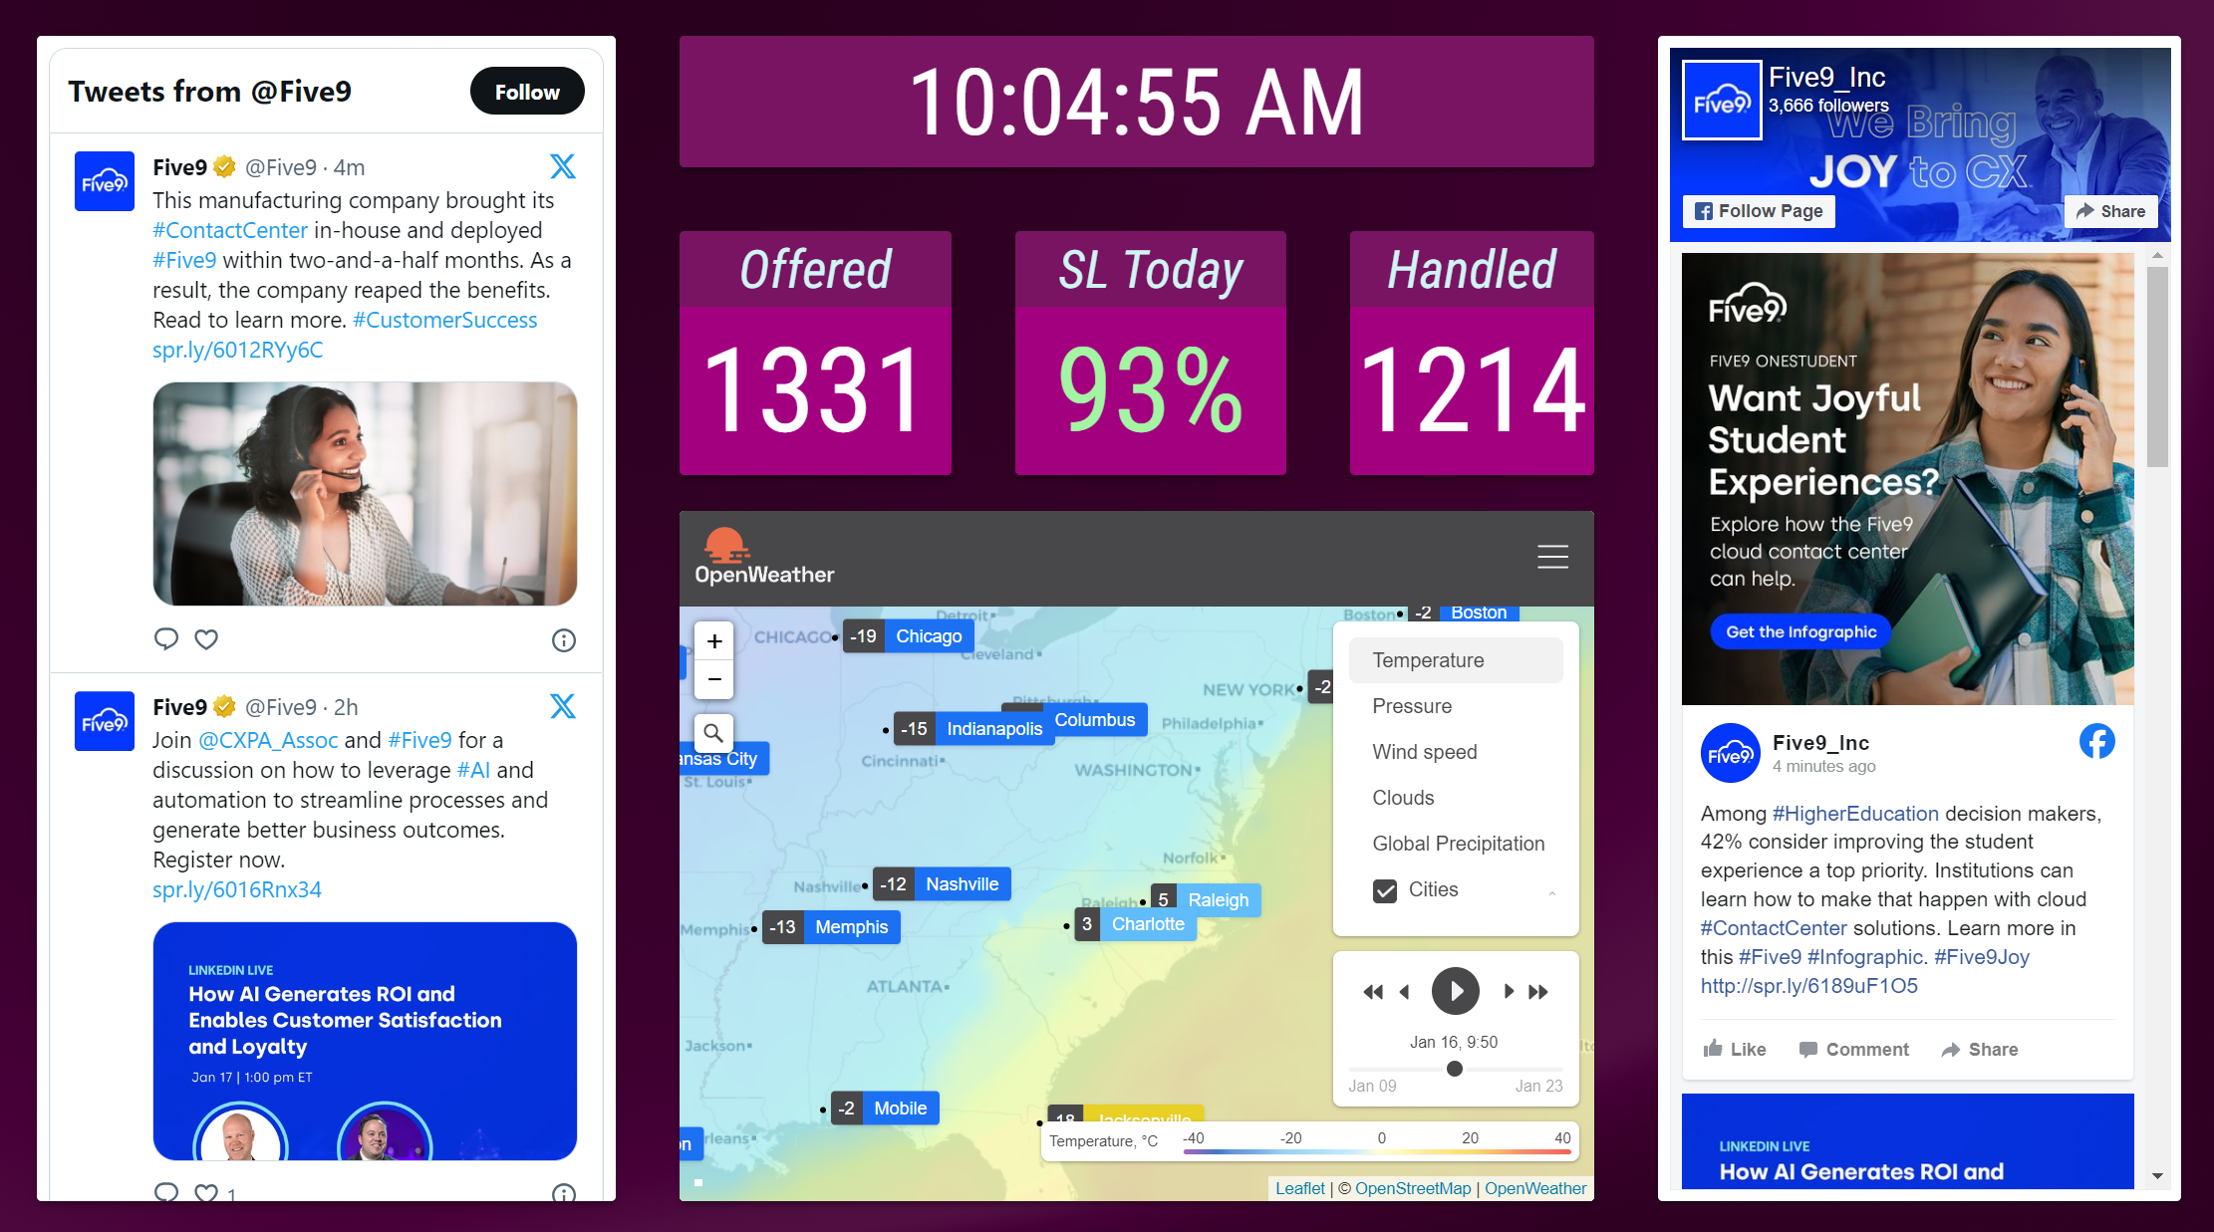
Additional External Content Types .. Digital Signage
Current time & date
Images
Marquees & Tickers
PPT / PDFs
Social media feeds
YouTube videos
Weather
Web pages - anonymous, iFrame

Slide 17
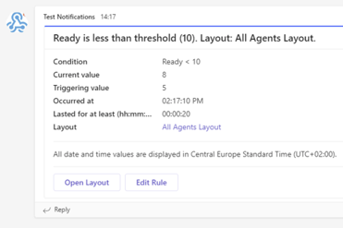
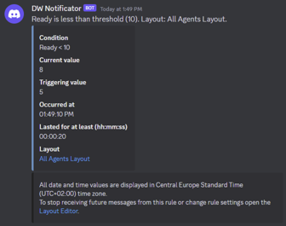
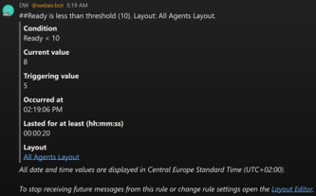
Real-Time Thresholds & Alerts ..
Pick your KPI / metric
Define your thresholds
Display alerts on your layout by
  Changing color & Blinking
  Playing a sound / announcement (audio recording)
Deliver alerts via email or to IM Clients (Webex, MS Teams, Discord, Slack), and/or via SMS/texting*
* A supported Texting API to be provided by the end-customer
Notes:
Polling Question #1: What IM platforms do you see used by your customers most often?
Options: Webex, Zoom, Slack, Discord, Microsoft Teams, Other

Slide 18

Business Units (BUs) / Data Silos ..
Crete multiple BUs to:
  Define security boundaries
  Split content into thematic containers
  Manage filters to map to your teams in your contact center
Business Unit
  Owns layouts and media files
  Owns user accounts and security settings
  Sets IP filter restrictions

Slide 19
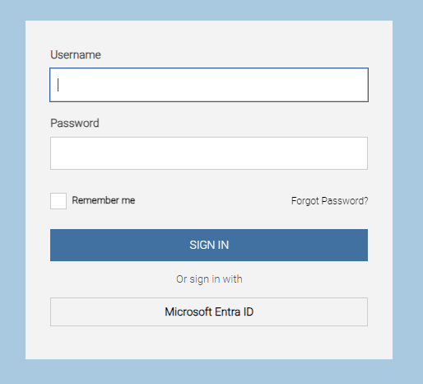
2Ring Cloud .. Single Sign On
Authenticate using credentials your users already know
Import users from your corporate directories
  Azure Entra ID (formerly Azure AD)
  Okta
Take advantage of all your corporate security controls such as
  MFA
  Password complexities

Slide 20
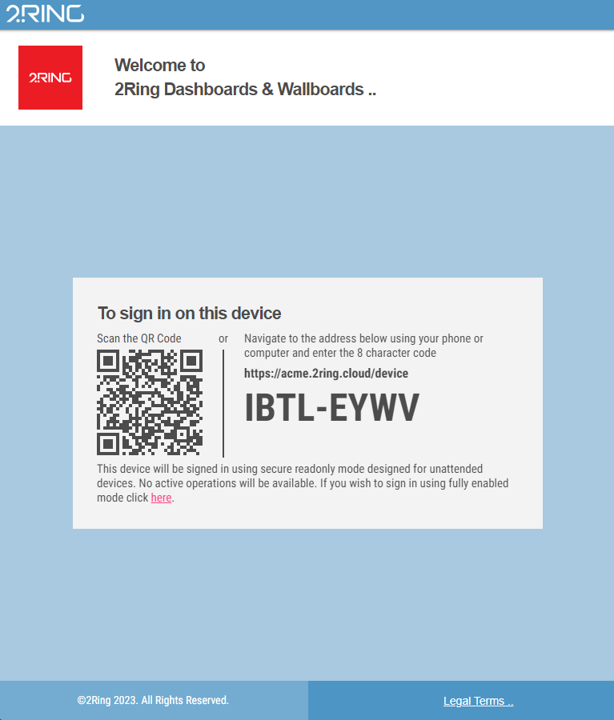
Device Friendly Login Experience
Sign in to TVs, Digital Signage and other keyboard less devices with ease
Use a QR code to sign in
  Securely from a PC or your cell-phone
  Devices gains read-only access
  Sign in once, and stay signed in until sign-out

Slide 21
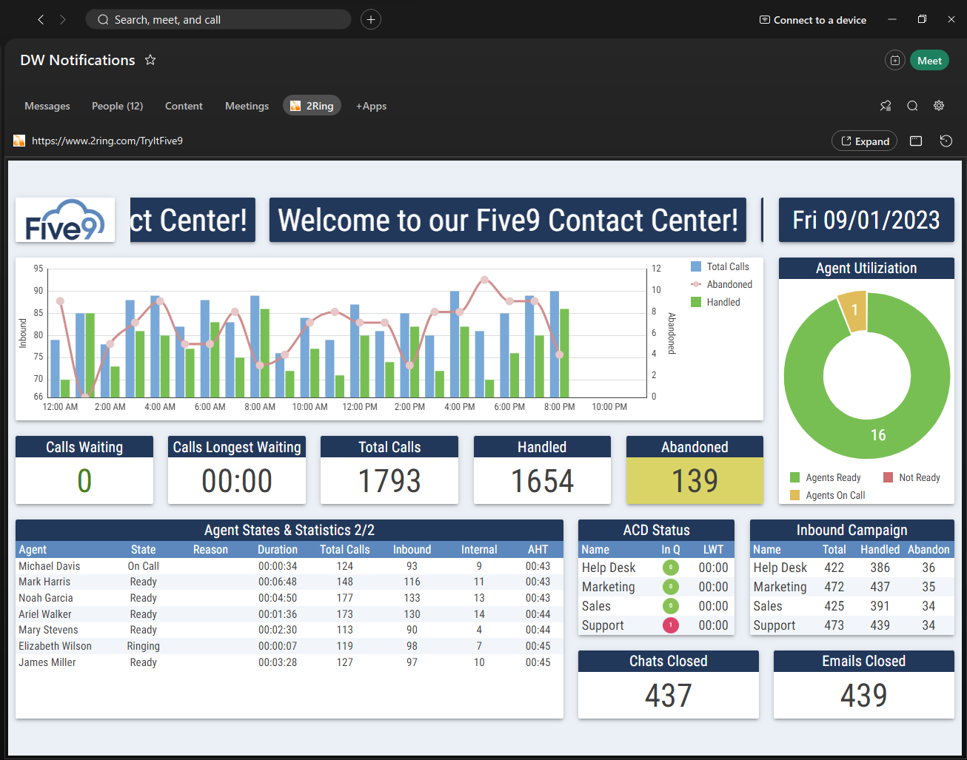
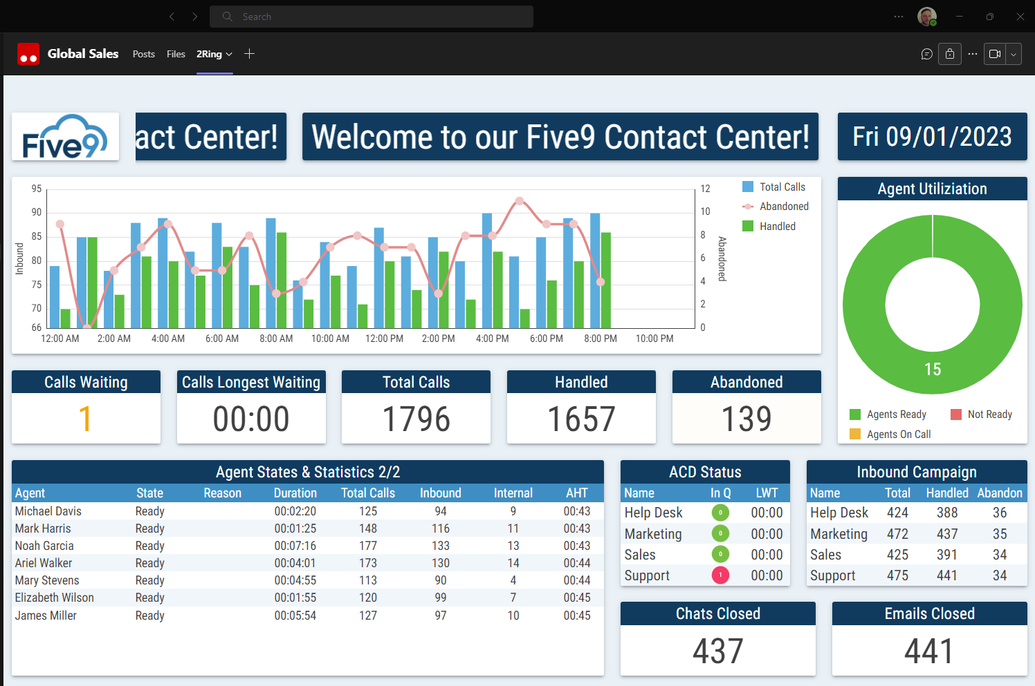
External Users & Sharing Access ..
Make it easy for the corporate managers to see what’s happening in the contact center
Embed layouts into Webex space or into MS Teams Channel
Share Layouts
With other BU administrators:
  Import/Export
  Shared BU
Using permalinks with Anonymous Access
Display on Large Screens
Self-hosted vs. Cloud

Slide 22
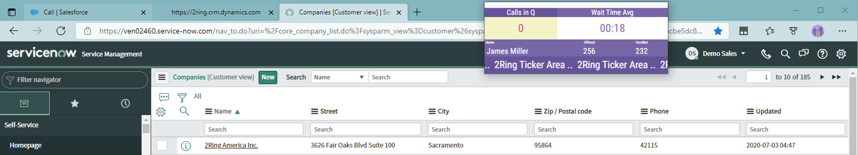
2Ring Power Tool (Personalized Wallboard) ..
Personalized grids
Create one layout and every agent sees his/her metrics only
Flexible window size
with embedded layout auto-resizing to the
space provided
Metrics can change
colors and blink based
on thresholds
Ability to a always
visible on top of all
other windows
Remembers its position
on the screen and its own window size
Can be set to auto-launch once agent logins to her/his workstation
Can contain a team-based message ticker – scrolling marquee
Deliver toast alerts based on any of the configured KPIs

Slide 23
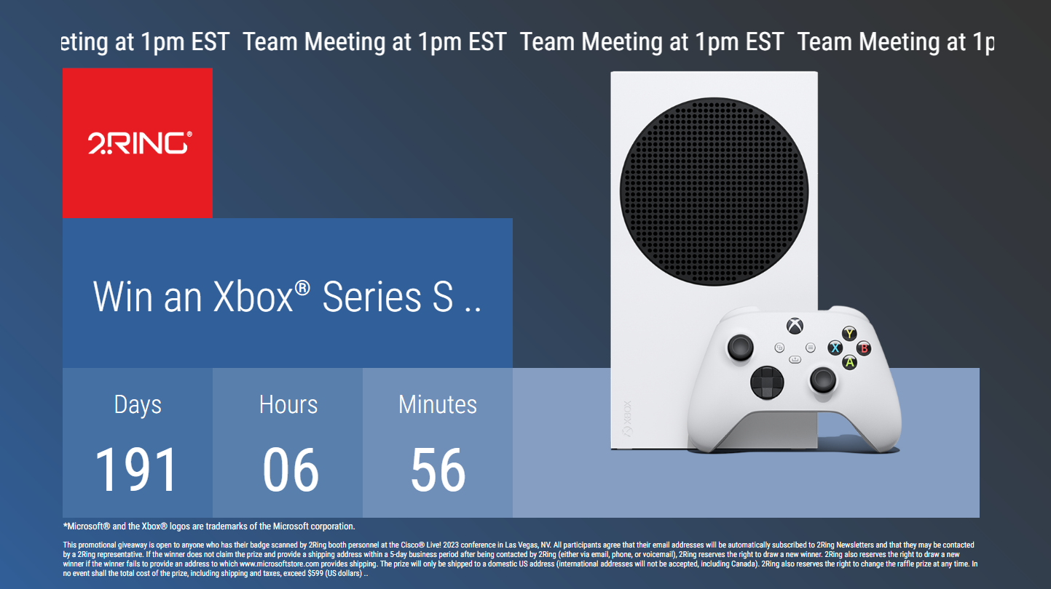
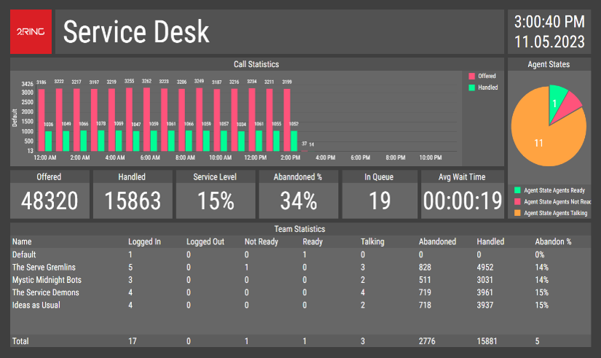
Your Content & Your Style ..
Use a background image or settle on a solid color
Use built-in fonts or supply your own
Filter, sort, and auto-page your grids for Agents, Queues etc.
Sequence segments or entire layouts
Combine multiple values into a single row (merge multiple queues into a single row)
Create layouts to your specific Enterprise
‘design manual and branding
Ad-hoc grid sorting & filtering by users
v

Slide 24
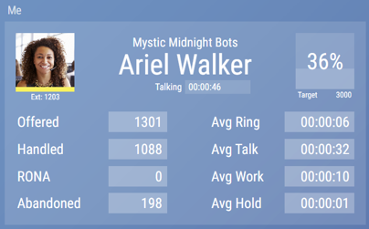
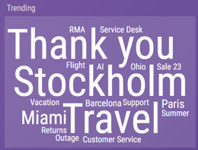
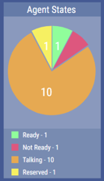
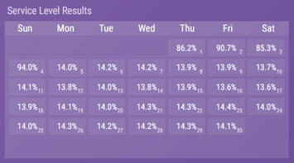
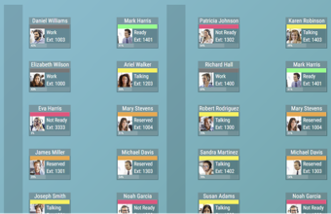
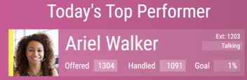
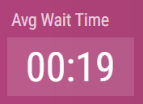
Widgets: Talking Heads / Floor Maps ..
Pie Charts, Timeline Charts, Word Cloud

Slide 25
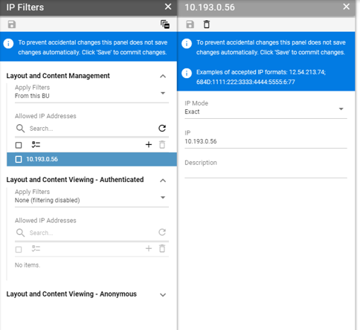
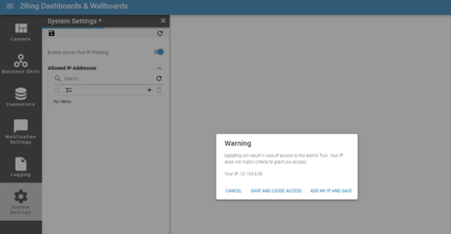
2Ring Cloud .. IP Filtering at BU Level
Anonymous Access
Can be Enabled and limited to:
  Specific Business Units
  IP addresses

Slide 26
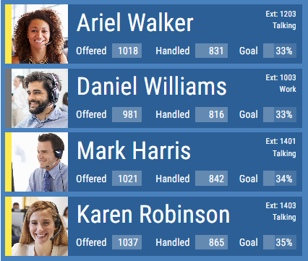
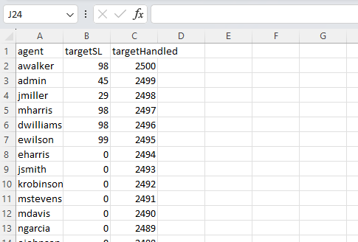
Importing Custom Data from CSV
Import and combine custom data with computed data provided by connectors
Suitable for tracking fulfillment of personal or team targets

Slide 27
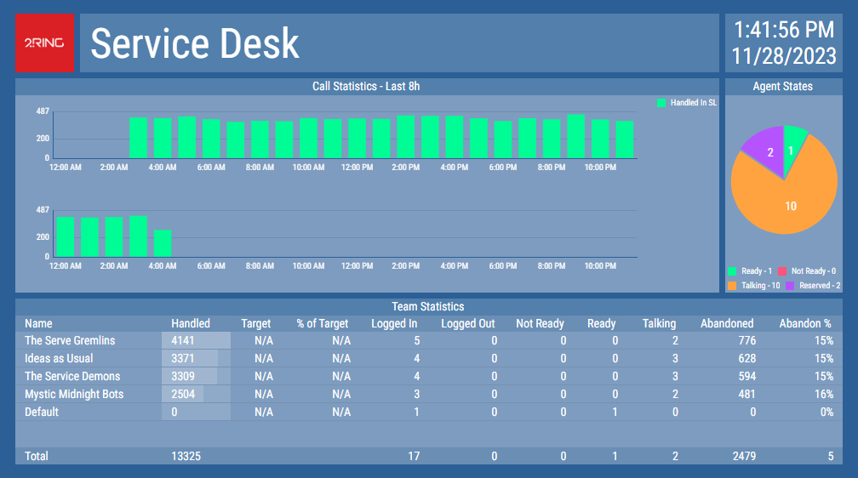
Historical Trending of Real Time Data ..
Compare current and past periods in easy to grasp charts
Average Wait Time This Month
vs Last Month
Calendar Showing performance on each day of the month (if threshold
for a team bonus was met that day)

Slide 28

Gamification: Highlight Personal Achievements ..
Engage you agents to perform better by providing gamification targets and real-time score evaluation
Use dynamic layouts to position best performers on top of the podium
Combine data with visual elements to deliver any artistic outcome

Slide 29



2Ring Dashboards & Wallboards: Technical Overview
Five9 Cloud Region
HTTPS/Rest API Responses
Possible Region Boundaries
HTTPS/Rest API Requests
Five9 Supervisor API
Five9 Reporting API
HTTPS/Rest API Requests
HTTPS/Rest API Responses
Websocket Statistics
2Ring Cloud (MS Azure Region)
Customer Premises
Kubernetes Cluster
Tenant Namespaces
HTTPS
Five9 Connector
Database
Tenant Services
Web Application
Gateway
Configuration Management
File Storage
L7 Firewall
DDOS Protection
Load Balancer
Geo Fencing
OWASP 3.1 Filter
Customer
Work from Home User
Shared Services
HTTPS

Slide 30
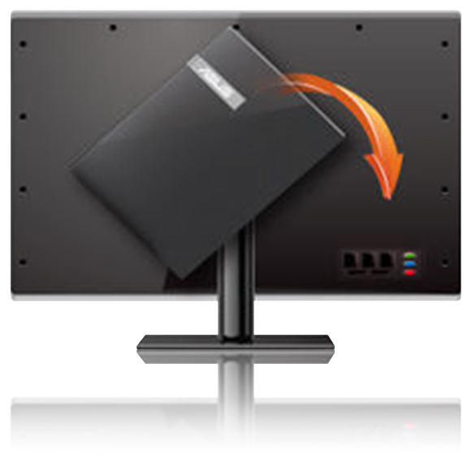
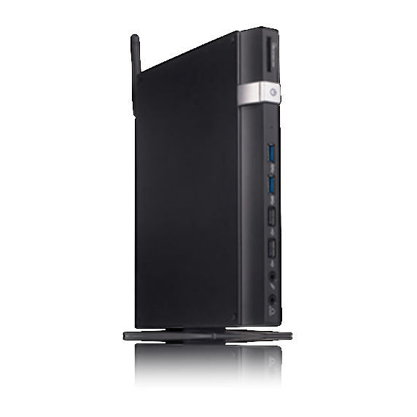
Hardware .. (not provided by 2Ring)
Screens
If you plan on using a smart TV, test it using www.2Ring.com/TryIt before purchase. E.g. Samsung has multiple different generations of smart TVs on the market, and older ones come with unsupported browsers.
PC / Mini-PC
Usually connected to a large screen via HDMI, VGA, or other cable.
Raspberry Pi
Enthusiasts can use Raspberry Pi. Reach out to us for tips.
PC Sticks
This is essentially a mini-PC which connects to the TV and has a browser running on it. There is no need to use TV remote control, you use your phone instead.
Digital Signage
2Ring also supports and integrates with AppSpace and Korbyt.

Slide 31
Contact Us ..

