Slide 2
2Ring Dashboards
& Wallboards for Five9 ..
How to Create a Personalized Wallboard & Set Up Flexible IM Alerts
Learn More: 2Ring.com/Five9
A Sample Wallboard Layout: 2Ring.com/TryItFive9
Request Full Demo Access: 2Ring.com/DWFive9Trial
Follow Us on Twitter: @2RingCX
Follow Us on LinkedIn: linkedin.com/company/2Ring

Slide 3

Who We Are ..
Founded in 2001
One of the fastest growing companies in Europe (2020)
100% Indirect Sales Strategy
Ossamah Shabbir
Mr. Shabbir (CCIE# 26891) has been focused on the success of Enterprise customers worldwide. Recently, he joined 2Ring to bring his extensive knowledge and enhance the agent/supervisor customer interaction experience with 2Ring Dashboards & Wallboards for Five9 ..

Slide 4
How 2Ring Enhances Five9 ..
2Ring Dashboards & Wallboards added-value:
Users make their own layout changes
Update dashboards without IT team involvement
Business-user friendly

Slide 5
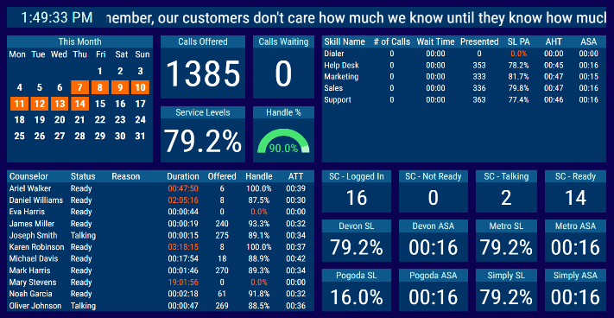
2Ring Highlights:
Your Content & Your Style ..
  Customize backgrounds
  Drag & drop functionality
  Pick colors/fonts/sizes
  Filter, sort, and auto-page grids
  Combine multiple values
  Configure scrolling banners/tickers/marquees
  Sequencing supported
  Display external content
Notes:
Use a background image or settle on a solid color
Drag & drop functionality as many segments as needed, resize each to your liking
Combine multiple values into a single row (merge multiple queues into a single row)
Combine multiple values into a single row (merge multiple queues into a single row)
Sequencing supported segments or entire layouts,
Display external content current time, weather, social media feeds, ..

Slide 6
Define Thresholds & Alerts ..
  Multiple threshold metrics
  Display alerts directly within grid
  or KPI: value changing color, blinking, & triggering audible alerts
  Supported IM Clients: Webex, MS Teams, Discord, Slack, and/or via SMS/texting*
Notes:
Supported IM Clients for alerting : Webex, MS Teams, Discord, Slack, and/or via SMS/texting* (API for texting needs to be provided by end user)

Slide 7

Review Important Info on One Screen when Connecting Multiple Data Sources ..
Give agents additional business relevant information (ERP / CRM Systems):
ServiceNOW
Salesforce
MS Dynamics
SQL

Slide 8
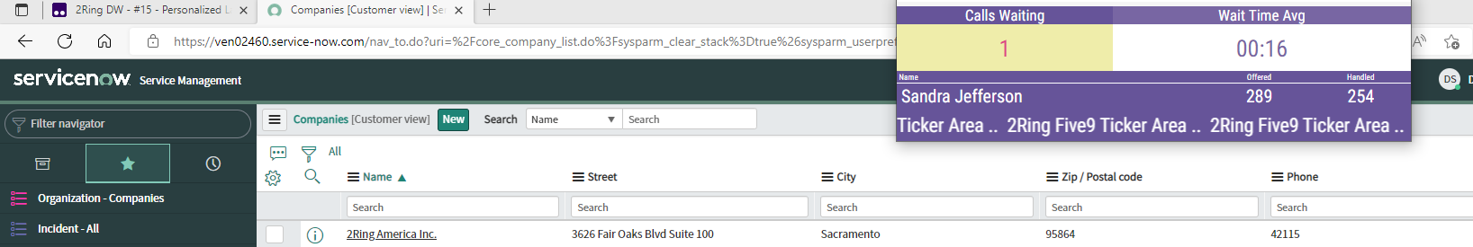
2Ring Power Tool
(Personalized Wallboard)
Personalized grids
Flexible window size
Set up metric thresholds for alerting
Always visible
Remembers its position; auto-launch upon login
Message ticker / scrolling marquee
Notes:
Personalized grids create one layout and every agent sees his/her metrics only
Flexible window size with embedded layout auto-resizing to the space provided
Metrics can change colors and blink based on thresholds

Slide 9
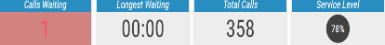
Dashboards & Wallboards LIVE DEMO ..

Slide 10
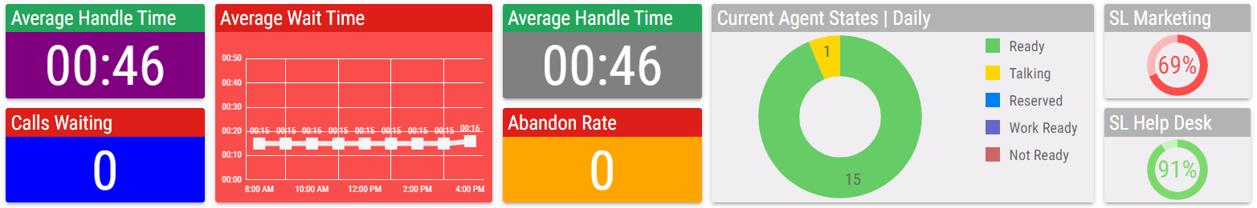
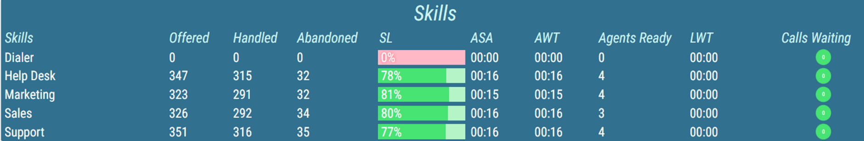
Dashboards & Wallboards LIVE DEMO ..

Slide 11
Live Demo Use Cases
(not on slide deck; description below for review purposes. This will be presented live.)
  Use Case: Agent checks how many calls they were offered and have fielded.
  Use Case: Agent looks to see how they’re performing compared to other team members.
  Use case: As a manager, you would like to see how many ServiceNOW tickets are open and the number that have been closed.
  Use case: The director needs to frequently see how different skill groups are performing compared to each other. The director easily drags and drops pre-configured KPIs/metrics to get the needed overview.
  Use Case: You, as the supervisor, identified a new KPI that you’d like to track in order to better understand the performance of your contact center. Use the layout configuration tool to make easy and fast changes.
  Use Case: As a supervisor, configure your Power Tool to show statistics of individual agents or entire skill groups. Be in the know about your team’s performance/metrics and react to evolving situations before they escalate.
  Use Case: A large volume is expected in the call center later today. You’ve decided that you want to notify agents so they’ll beware of the large influx and abnormally high call volumes. Set up a broadcast message that will appear in a specific dashboard layout or even within the 2Ring Power Tool. Communicate urgent messages using this system.
  Use Case: You want to know which agents are performing at their best, seeing that you want to encourage a productive work environment. Gamify views in your dashboard layouts and view the top performing agents. Visually showcase charts and motivate your workforce by promoting healthy competition.
  Use Case: A supervisor needs to be alerted when the number of calls waiting exceeds a certain limit. Set up alerts using 2Ring’s user-friendly interface.

Slide 12
Questions?
Interested in a live and personalized demo of 2Ring Dashboards & Wallboards?
Please visit the 2Ring Booth
in the CX Hub for a live demo
or request a private demo at
www.2Ring.com/Five9Demo

