Slide 1
Top 10 Cisco Contact Center Use Cases
by 2Ring
Lyall.Shepperd@2Ring.com
VILCCT-1008

Slide 2

Automated State Changes
#10
www.2Ring.com
When placing outbound calls
there was a lack of visibility.
Used a workflow that would set
state to “NotReady Outbound",
and when the call was released agent is placed back to Ready
Dynamically Extending
Wrap-Up Period
Log everyone out after 5PM

Slide 3
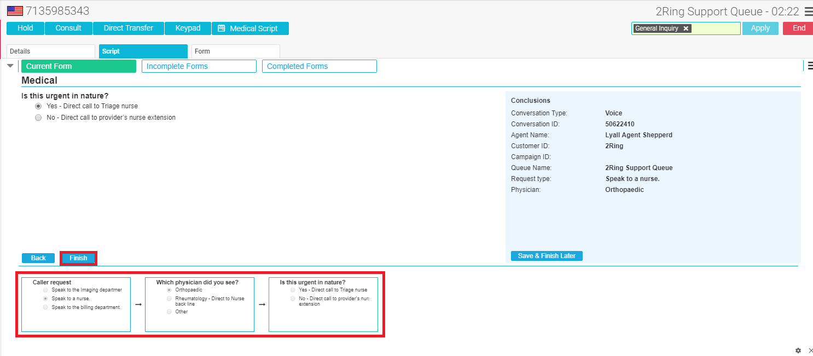
Call Triaging with Action
#9
www.2Ring.com
Medical scripting with transfer
Gather intake information
and e-mail intake specialist
or attorney

Slide 4
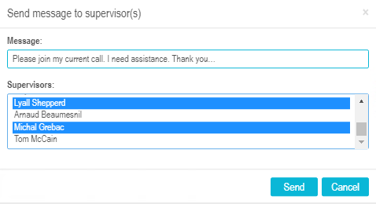
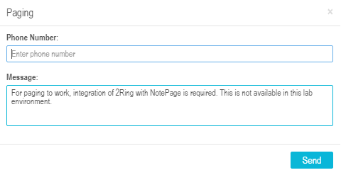
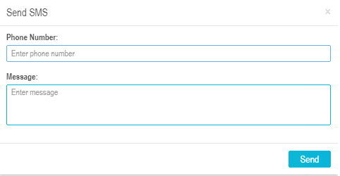
Buttons and Buttons Again
#8
www.2Ring.com
Panic Button Form
Submit New Request Form (replacing SharePoint Forms)
Healthcare Buttons / Code red Automation
Open gates at a car parking lot
One click conference call setup
Agent state change with single click
Extend Wrap-Up Time
Bookmarks

Slide 5
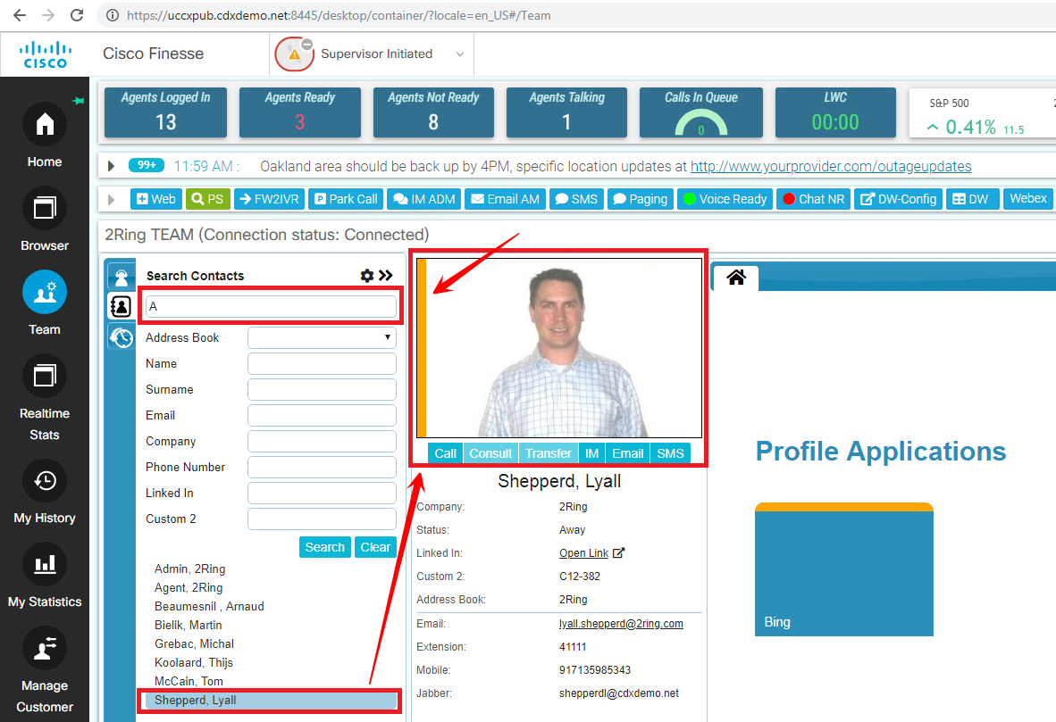
Address Books with No Limits
#7
www.2Ring.com
Synced address books – unlimited number of contacts from multiple data sources (LDAP/AD, CUCM, Exchange, Lotus Notes, SQL DBs, csv files) available for agents to search (without the need to place a caller on hold)
Manually managed address books
Agent personal address books - agents can create their own address books
2Ring Generic SQL connector can query address book for caller look ups
See presence status (CUPS) of contacts

Slide 6
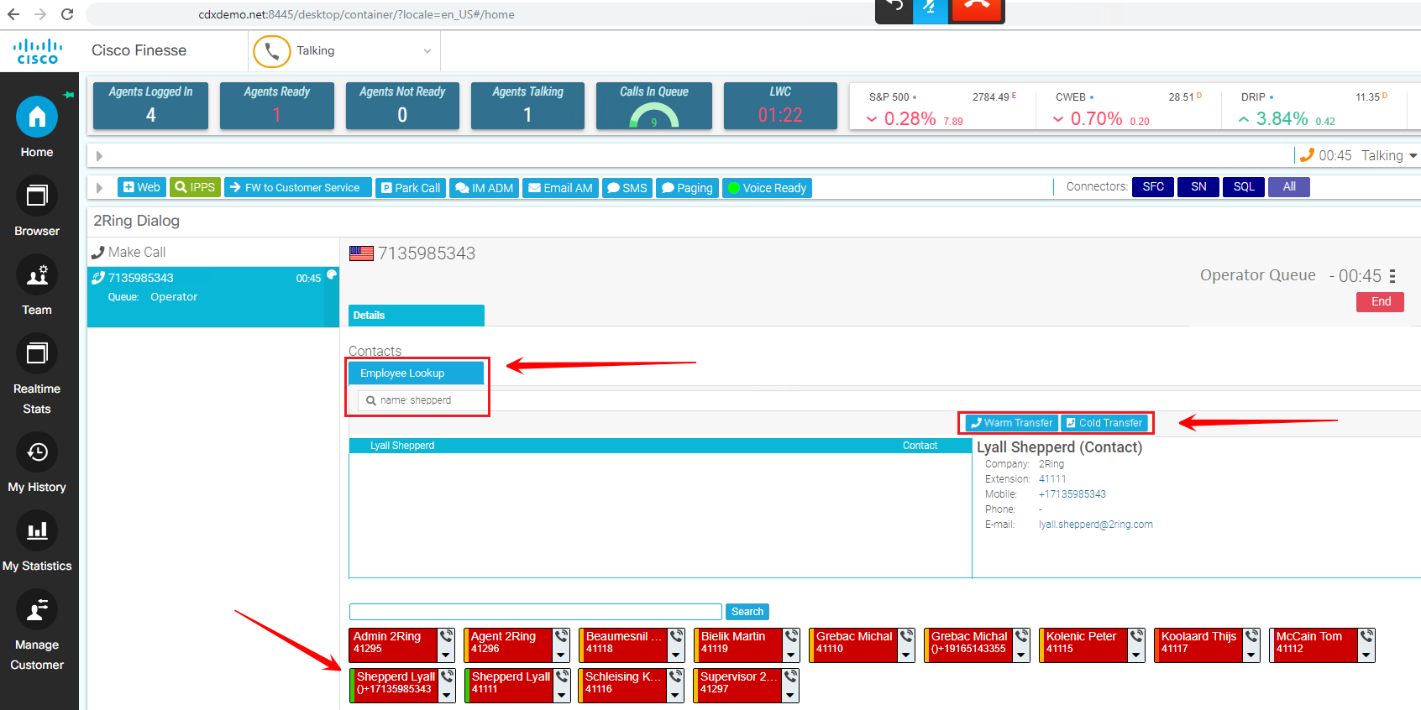
Cisco Finesse = Attendant Console
#6
www.2Ring.com
Address Books with no Limits
(see previous use case)
Buttons to Transfer the Caller
Call Picking / Parking (UCCX only) to select which call the operator takes next or to park calls during busy periods
Multiple set of Speed Dials
with different actions
Integration with CUPS to show presence of backoffice workers
Texting Integration (WebText, ..)
Paging Integration (NotePage, ..)

Slide 7
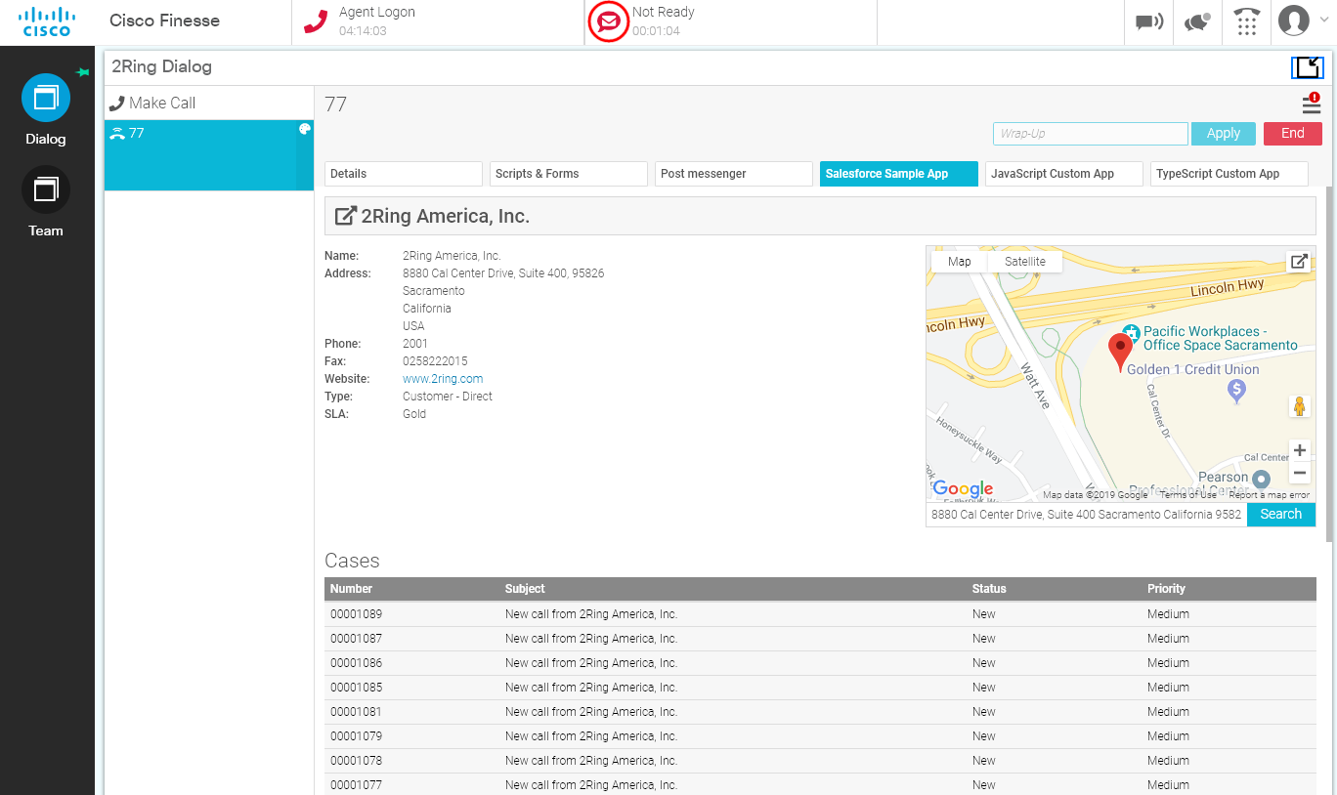
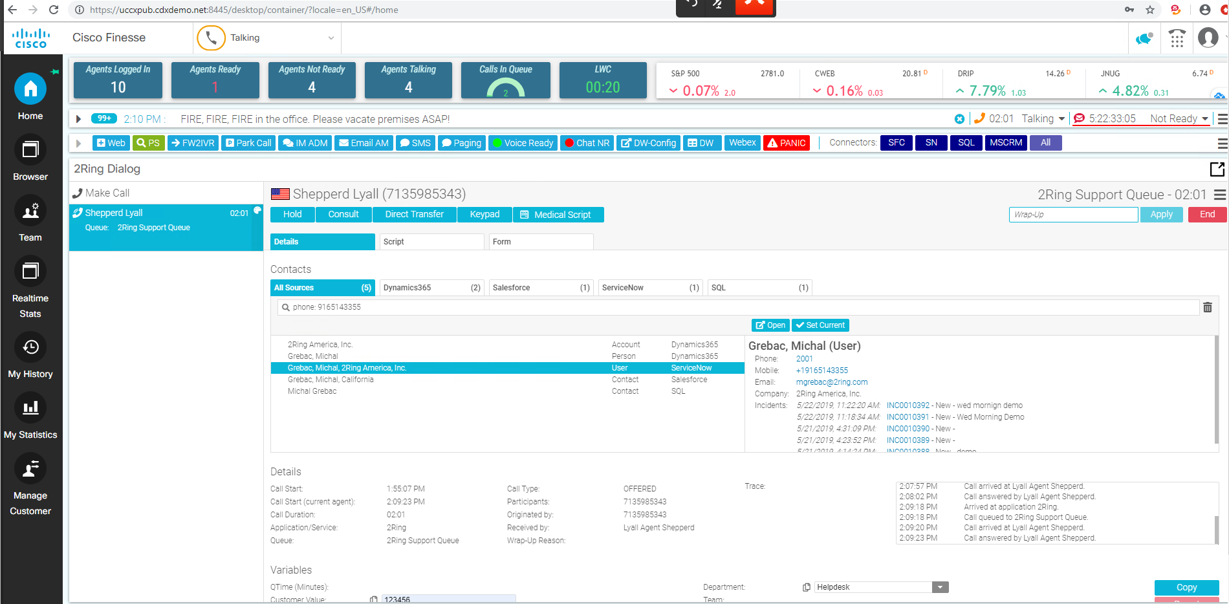
Intelligent CRM Screen-Pops
#5
www.2Ring.com
Supports lookups in multiple systems at the same time
Pop-ups the right system depending on what kind of call / interaction it is
Hospital Admit Discharge Integration - Simple screen that hospital operators can use to lookup
a patients by name and find location details and the patient
Button to Warm & Cold Transfer
the caller

Slide 8
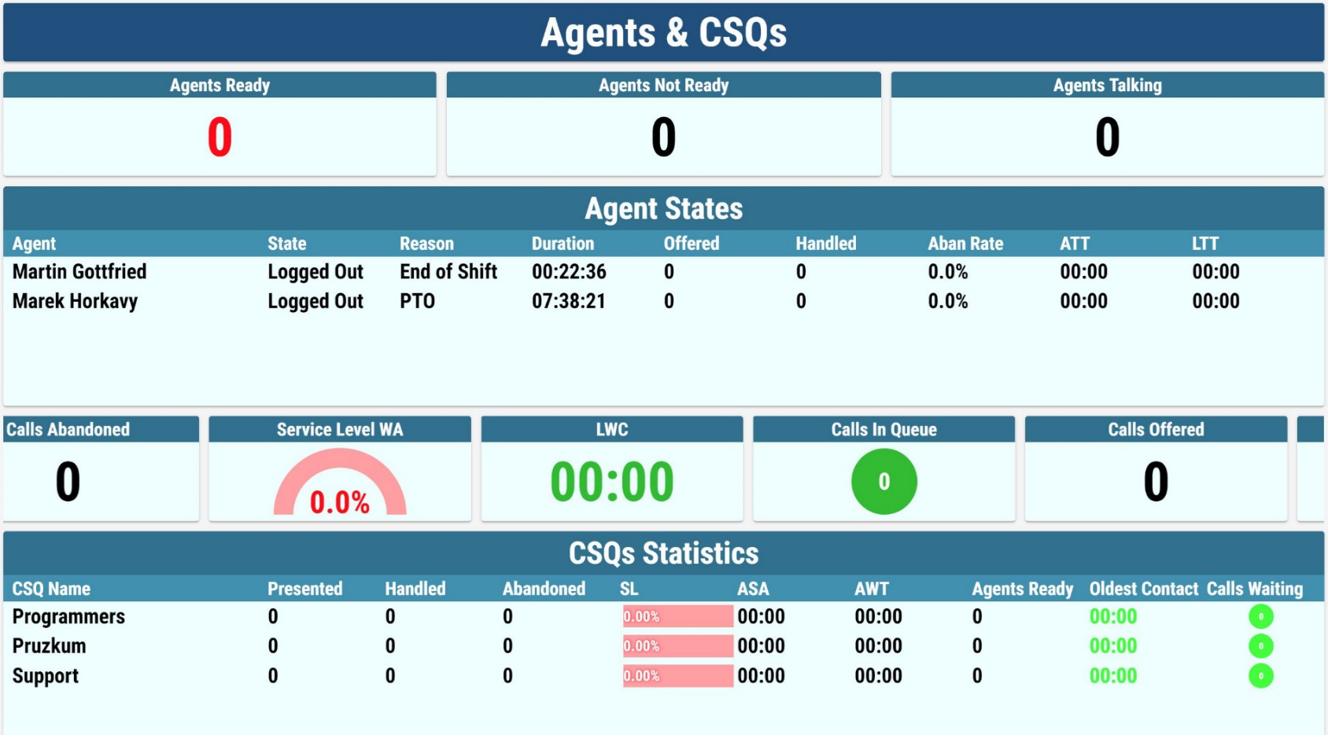
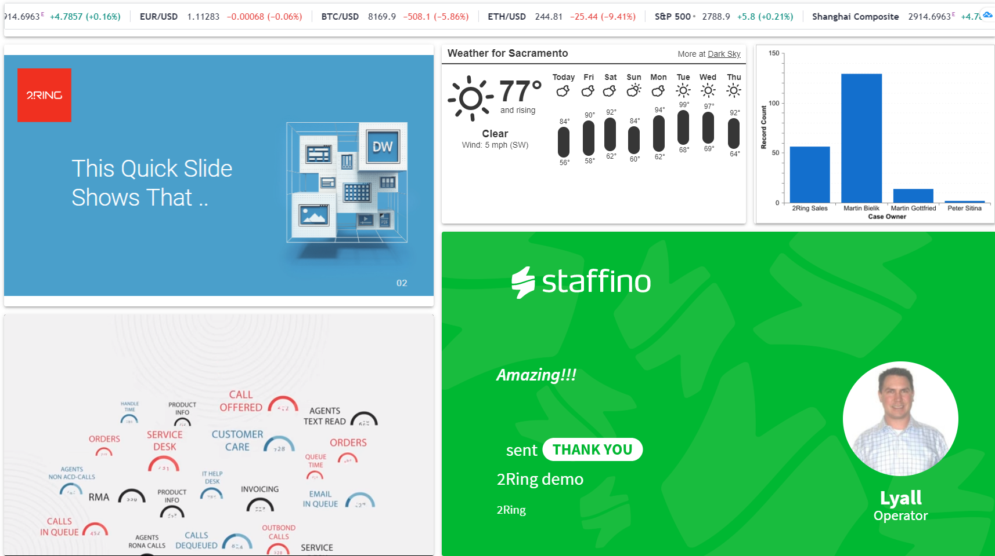
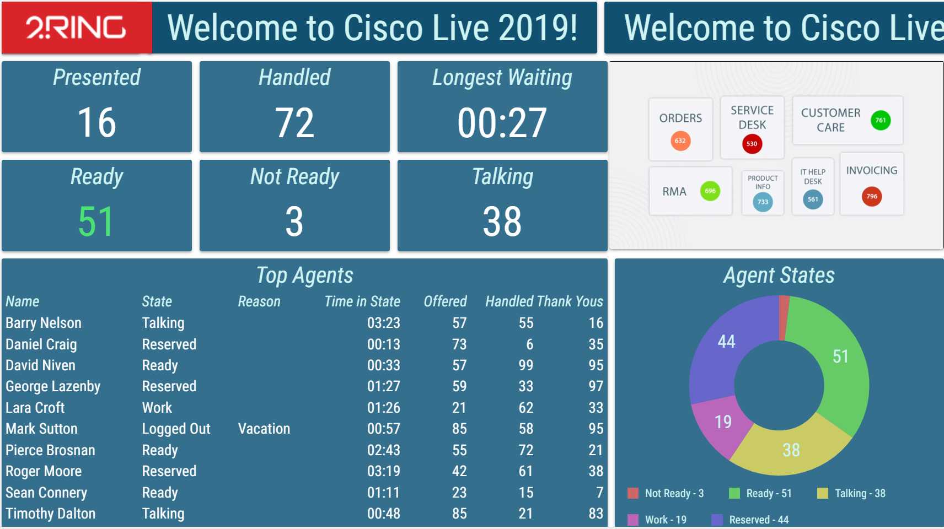

User Friendly Realtime Reporting
#4
www.2Ring.com
See a sample layout at www.2Ring.com/TryIt
Watch the episode we recorded here on Tuesday at www.2Ring.com/Deathmatch

Slide 9
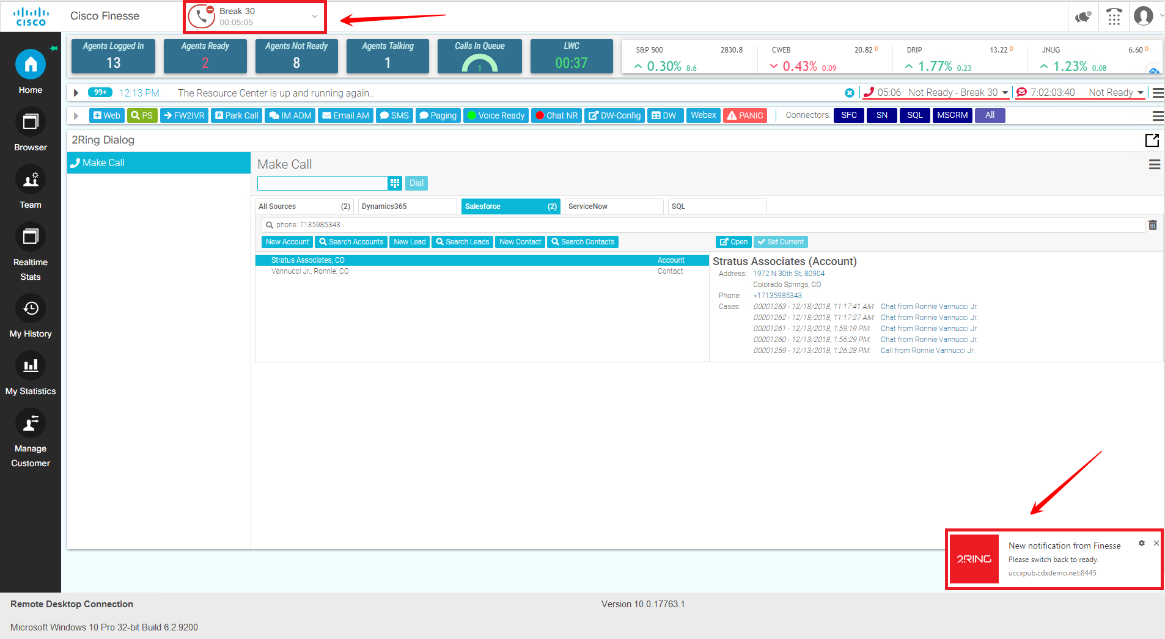
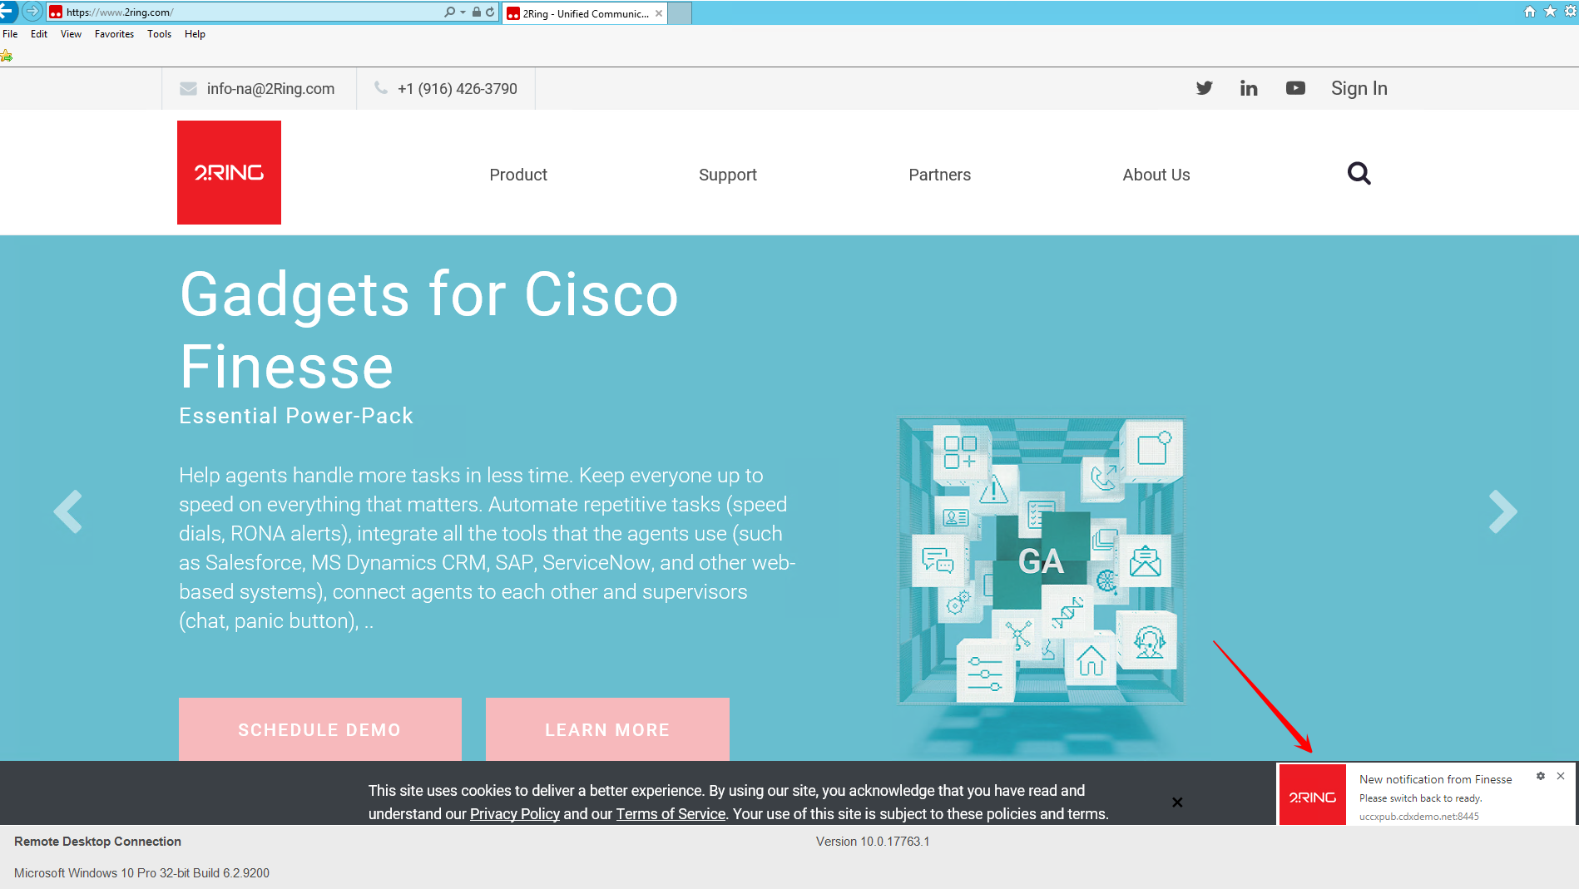
Stay on Top Alerts
#3
www.2Ring.com
1. Calls in Queue – combine multiple metrics, such as number of calls in queue and longest waiting call is over x seconds
2. RONA – agent and supervisor can receive a Toast Notifications with a clickable actions, such Go Ready
3. Approaching Handle Time – help agents achieve their talk time targets
4. Cumulative Not Ready for the Day – help agents achieve NotReady targets
5. Use Toast Notifications for Ready / NotReady Buttons - agent always know state
6. Pick a Wrap-Up Code Reminders
7. Queue Long Wait Time Apology
8. Personalized Opening Sentence – based on hour, queue, IVR selection, # called, agent's name, …
9. Severity 1 (life threatening emergency) call in queue. On UCCX, when the agent click the toast notification the current caller is parked and the agent can select the Severity 1 call for answer.

Slide 10
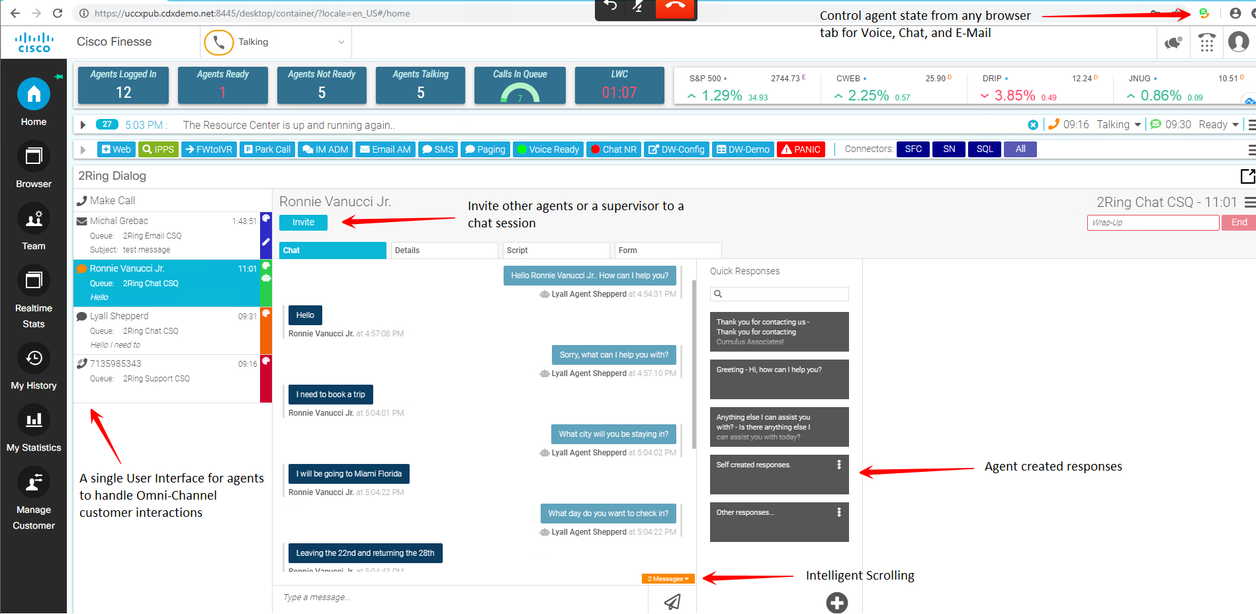
Omnichannel
#2
www.2Ring.com
Customer Details & List
of Previous Interactions
in One Place
Support for multi-match scenarios
CRM integrated – auto activity/interaction record
creation in selected system(s)
BOT integration for automated handling of UCCX chat sessions
Texting integration with UCCX
Automated cc-ing or bcc-ing additional parties in UCCX emails

Slide 11
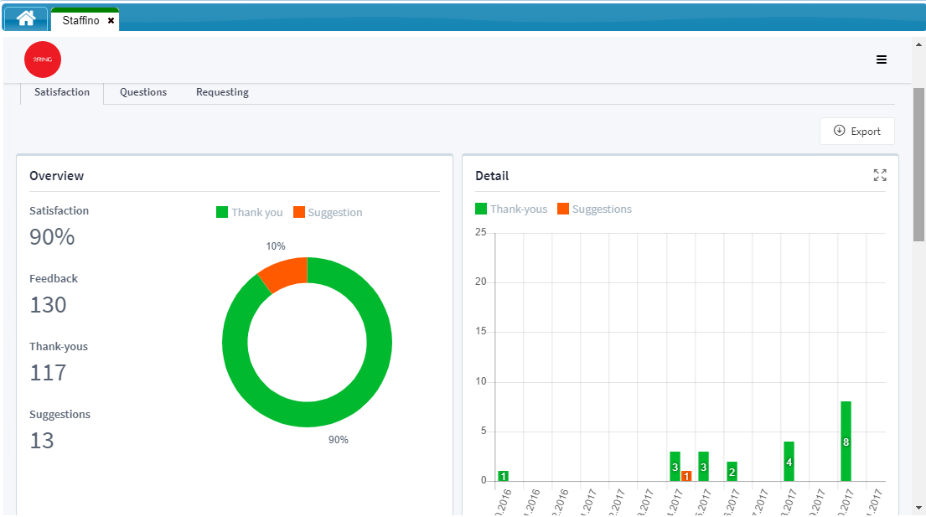
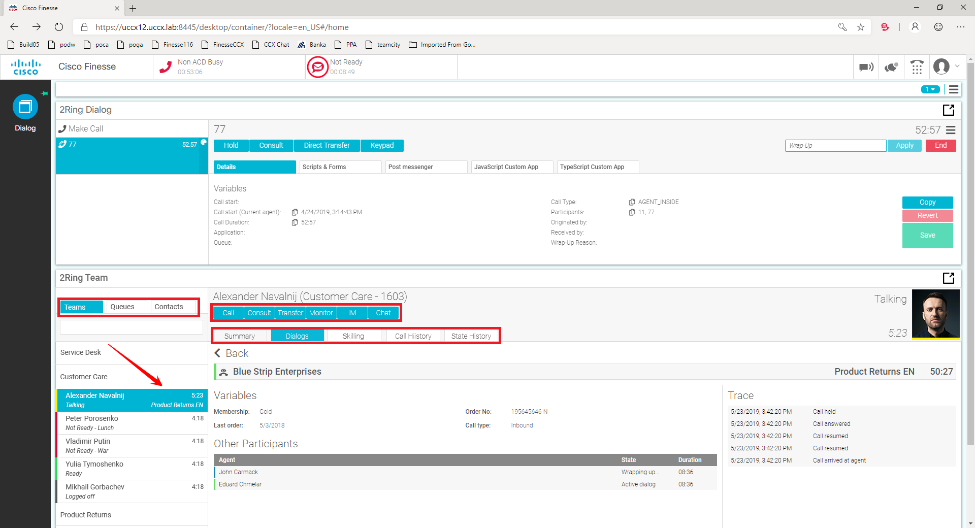
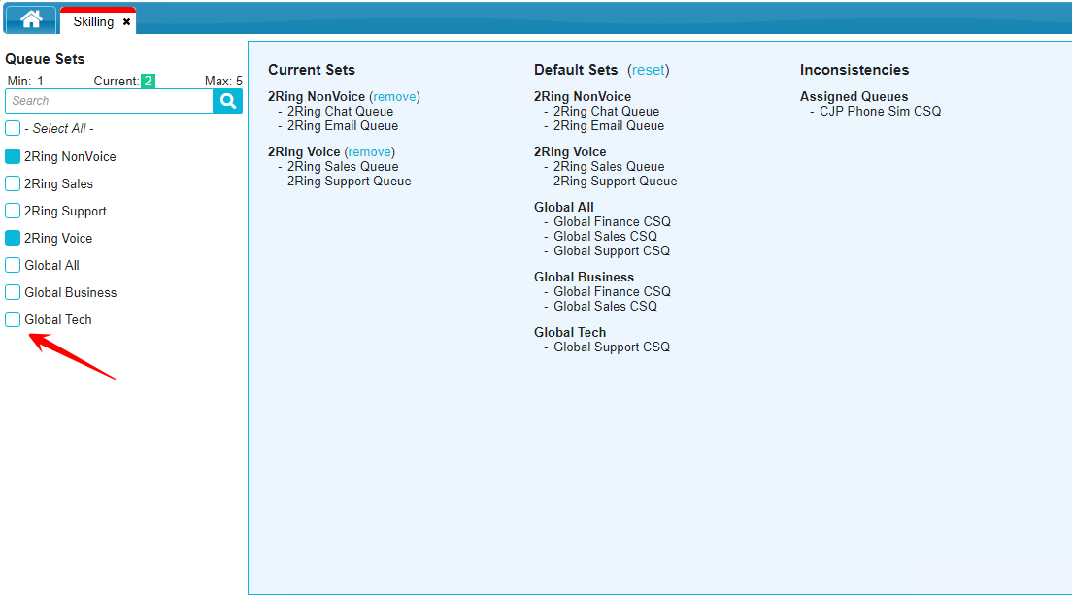
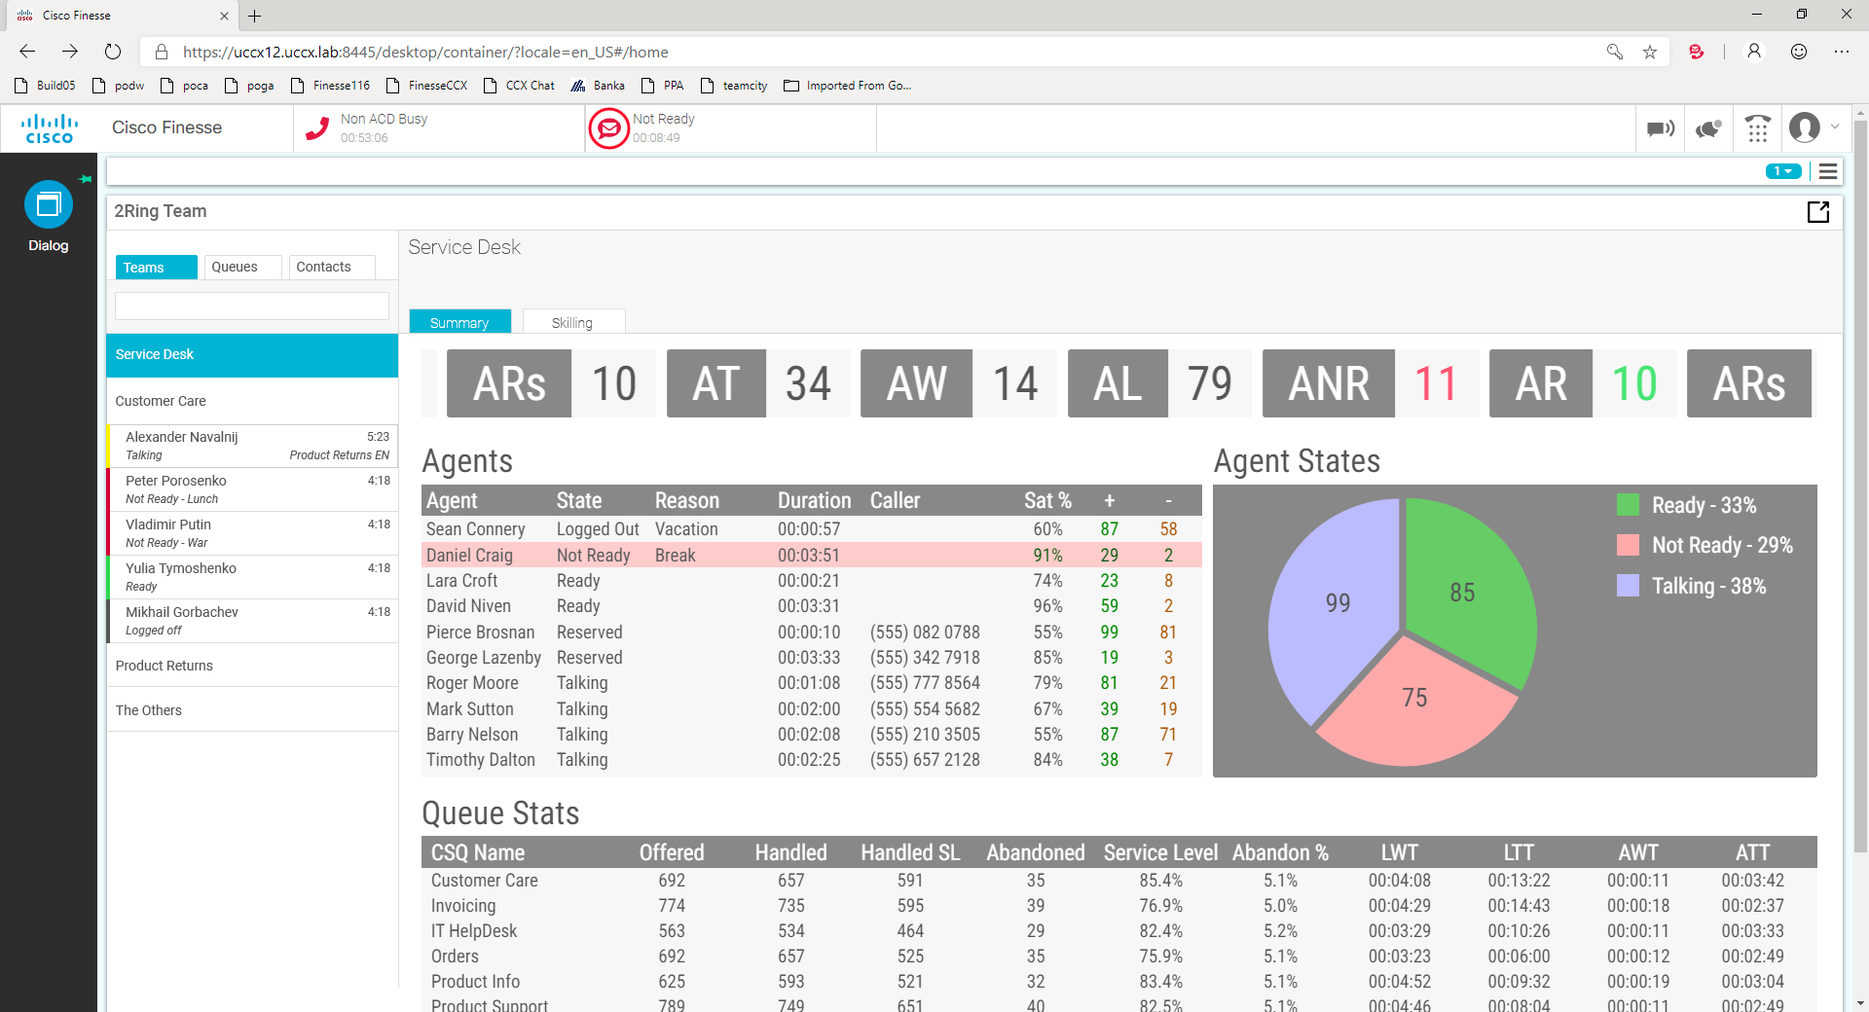
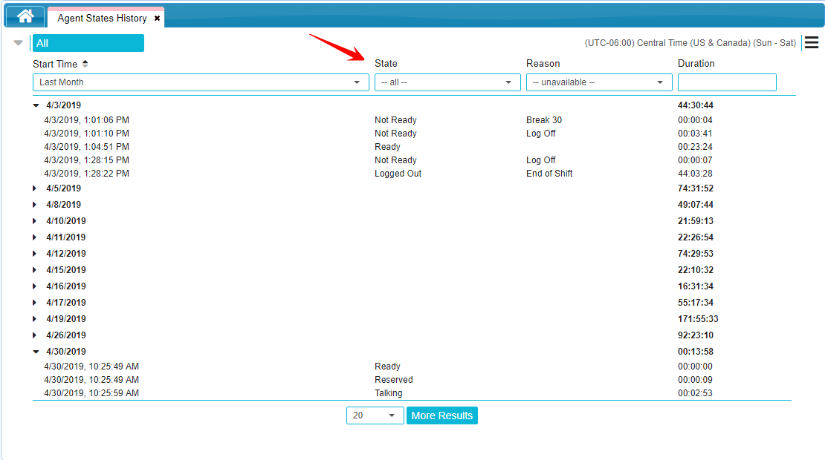
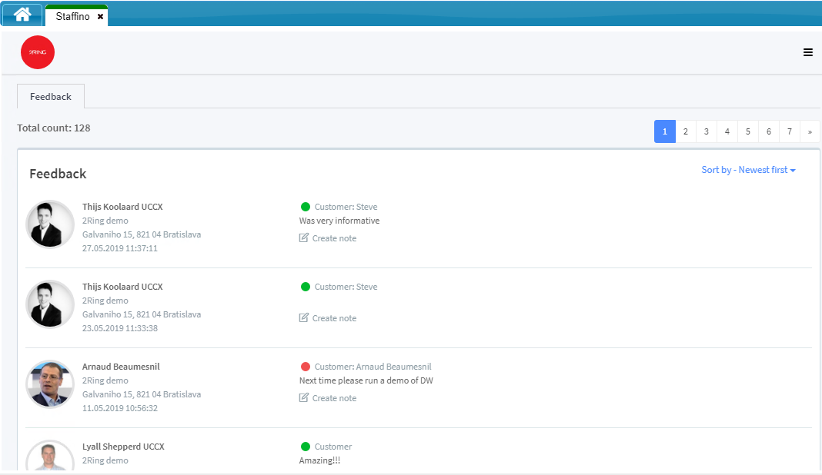
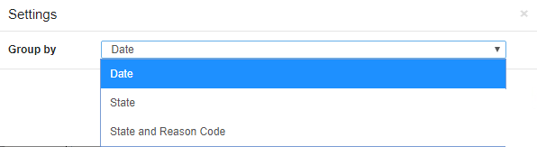
Supervisor Cockpit
#1
www.2Ring.com
Searchable List of Agents from Multiple Teams
Agents Grouped by Teams / Queues / SkillGroups
Searchable Calls History
State History with 3 Types of Groupings
Current call details
Current chat session content (UCCX only)
Current email content (UCCX only)
Customer Satisfaction with Agent (2Ring Staffino Feedback Service)
Per Team Grids showing many metrics using Dashboards & Wallboards
Agent Reskilling (Agent Self-skilling Option)
Access to Contacts from the back office / external chat with IM Button (Jabber, Skype, Hangouts, Slack, Teams, ..)
And much more

