Slide 1

2Ring Dashboards
& Wallboards .. v8.2
Deliver Personalized Information
to Every Screen
Learn More: 2Ring.com/Amazon
A Sample Wallboard Layout: 2Ring.com/TryItAmazon
Full Demo Access: 2Ring.com/DWtrial
Follow Us on Twitter: @2Ring4UC
Follow Us on LinkedIn: linkedin.com/company/2Ring

Slide 2

About 2Ring ..
Founded in 2001
Global Presence / Global Customer Base
  European HQ in Slovakia
  North America HQ in Sacramento, CA
Among 1000 Europe’s Fastest Growing Companies in 2020
ISV Partner with Amazon, Genesys, Cisco, ServiceNow, Microsoft, ..
  Amazon Listing: TBD
Indirect Sales Strategy
  Reseller contracts in place with NTT (multiple countries incl. USA + Canada, Australia, ..), ConvergeOne, and many other relevant resellers in the contact center space (CDW, Presidio, WWT, …)

Slide 3
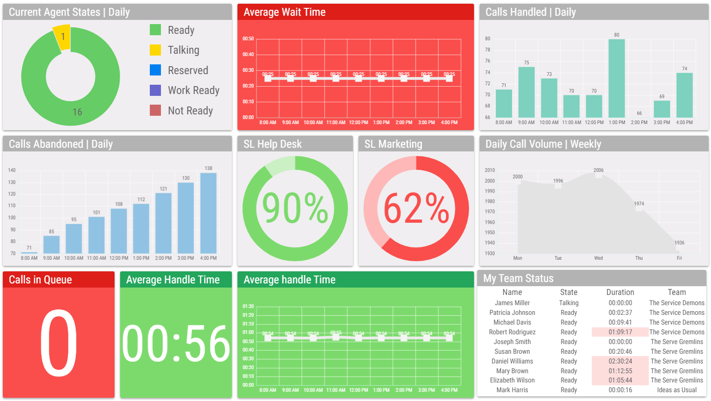
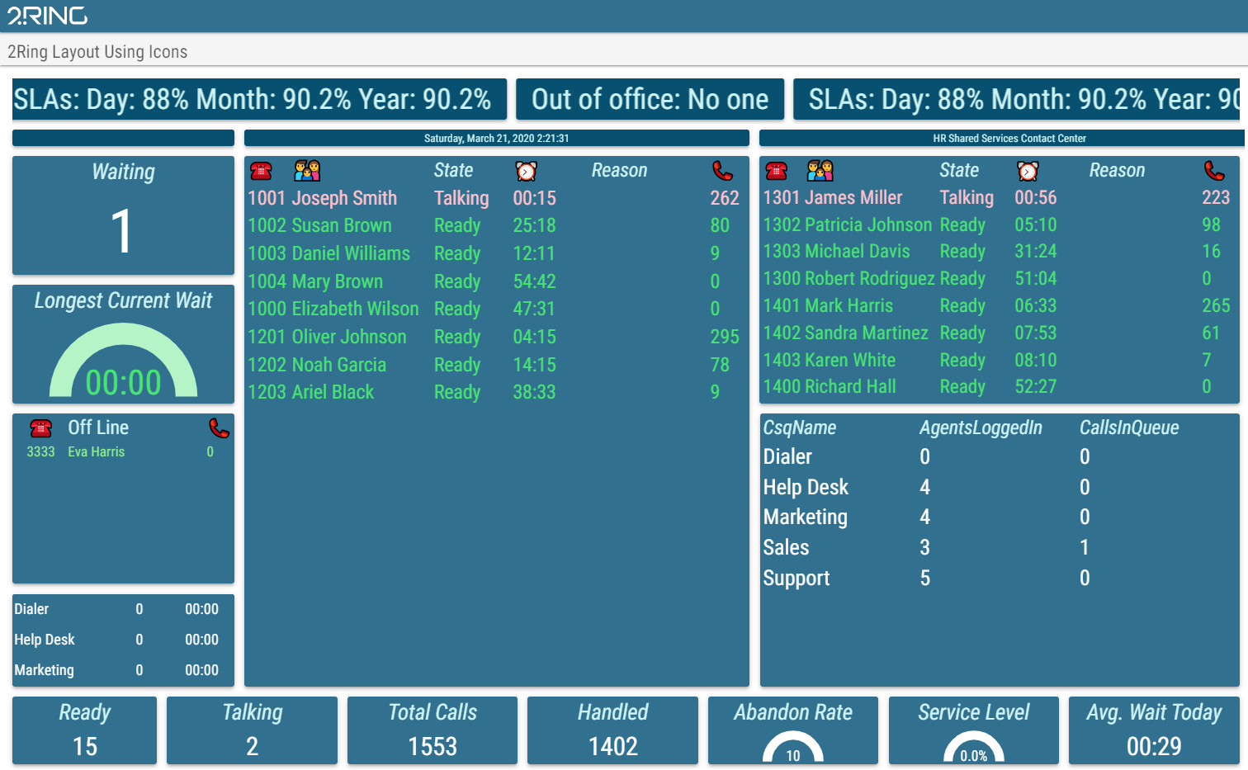
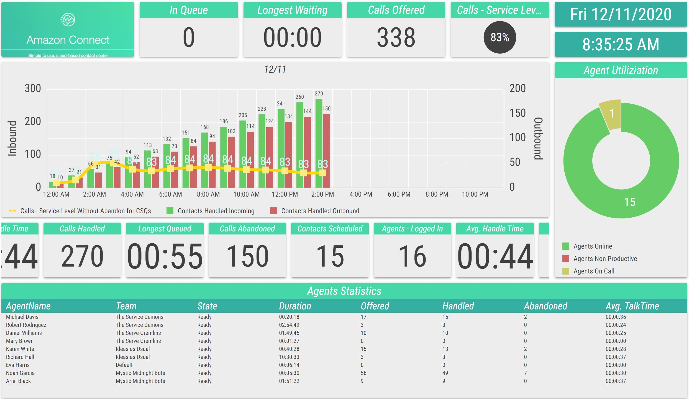
A Live Layout is Available at:
www.2Ring.com/TryItAmazon

Slide 4
Business Case for 2Ring Dashboards & Wallboards
Stay informed no matter where you are (web-based layouts)
  Provide real-time information on contact center performance, even to users who are not part of it (permalinks)
Review all important information on one screen (multiple data source)
  Provide agents with additional business relevant information (ERP / CRM Systems)
Break-down stats for different skill-groups, sites, .. (unlimited number of layouts)
  Create special layout for your service desk (Ticketing System)
Show metrics that matter to your users (out of the box + derived calculations)
  Merge data for multiple queues / skill groups into one row / KPI
  Utilize the support for creation of CUSTOM calculations
Support competition among agents
  Create Top 10 or Bottom 10 views
  Show trends – e.g. number of calls handled over the recent period (e.g. last 4 weeks)
  Show feedback received via 2Ring Feedback Service: www.2Ring.com/Staffino
Broadcast messages to a scrolling text marquee

Slide 5
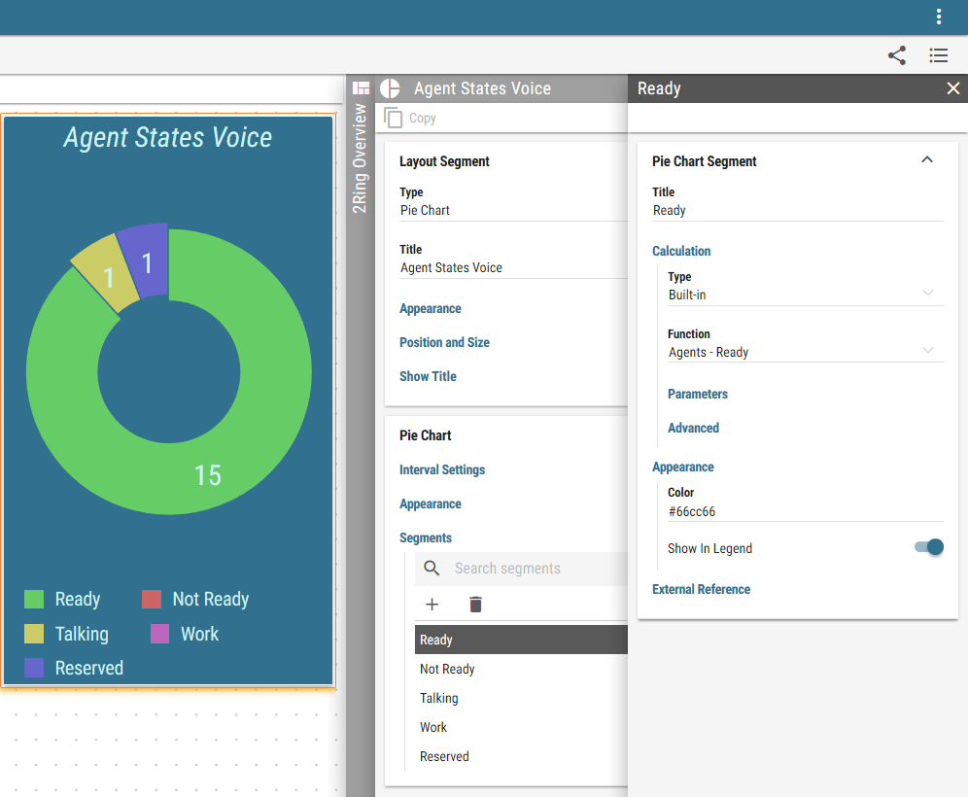
Real-Time Reporting Friendly to Business Users
Built-in layout editor (Web-Based)
  Touch-screen friendly with drag & drop support
  All options available via context menus on the right
  Changes applied immediately to the layout’s preview on the left
Layout segments can overlap
Layout parameters
  Layout can define parameters that are inherited by all KPIs, grids, charts, etc. When the value of the parameter changes on the layout, all child sources reflect it automatically.
Multi table grids
  A grid can be composed of multiple tables. This allows for combining multiple tables from the same or even from different connectors! For example, a single grid displaying stats from a call center, a ticketing system, and a CRM/ERP system.
Content Picker/Uploader
  Uploading an image or a pdf was never easier. Upload a file directly on the same spot you are asked to pick one.

Slide 6
Multiple Data Sources / Content Types
..
  Amazon Connect
  Cisco CUCM (CallManager)
  Cisco UCCE (incl. Packaged)
  Cisco UCCX
  Cisco Unity
  Cisco Webex Contact Center (WXCC)
  Genesys PureEngage (on premise)
  Salesforce (Dashboard Elements)
  ServiceNow (SNOW)
  UpstreamWorks
  PowerPoint Slides – PDF
  SQL data sources for ad-hoc integrations other business applications
  Staffino Customer Feedback
  YouTube videos & streams
  Web Content - anonymous, iFrame
  Weather – Current and Forecasts

Slide 7
E A S Y T O
C R E A T E
..
  Layouts that YOU build. Once you change your mind, YOU make all the necessary updates thanks to business
  user friendly configuration with drag
  & drop support ..

Slide 8
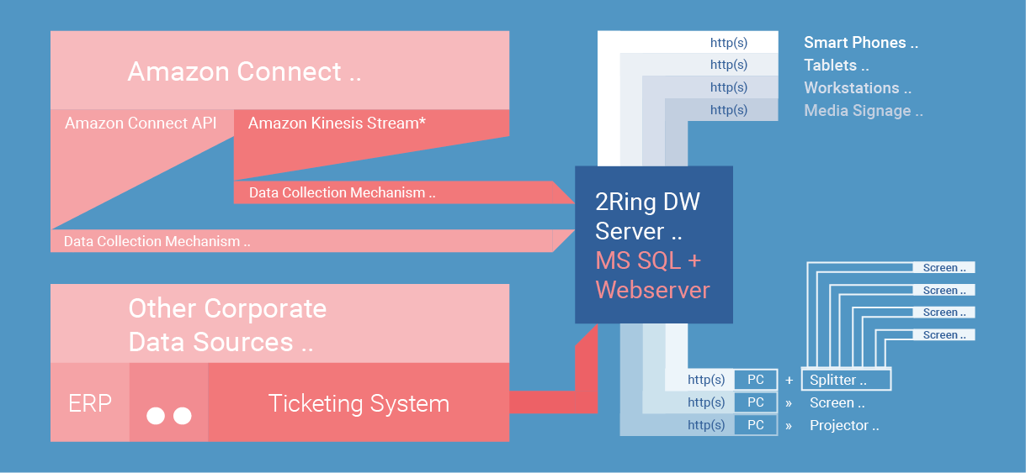
How 2Ring Dashboards & Wallboards (DW) Works

Slide 9
System Requirements
Server
  Microsoft Windows Server 2016 or later
  Microsoft .Net Framework 4.8 or later
  IIS 8.0 or later
  Microsoft SQL Server 2016 (or later) Express Edition (and above)
Azure AD Integration
  Possibly integrated with Azure AD
  Local accounts possible
  Anonymous access links (permalinks) can also be created ..
Workstation / End-User Device
  Modern Web-Browser – Chrome, Edge, Firefox, Safari
  Access to TCP port 80/443 of the 2Ring DW Server

Slide 10
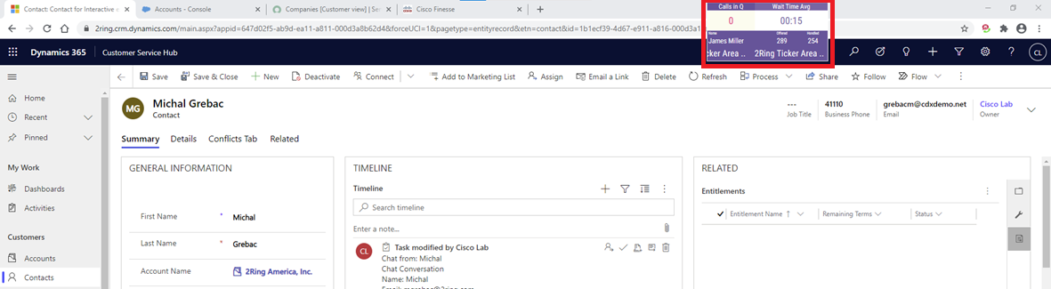
2Ring Power Tool (Personalized Wallboard)
Ability to be always visible on top of all other windows
Flexible window size with embedded layout auto-resizing to the space provided
Personalized grids – build one layout for every agent seeing his/her metrics only
Remembers its position and window size

Slide 11
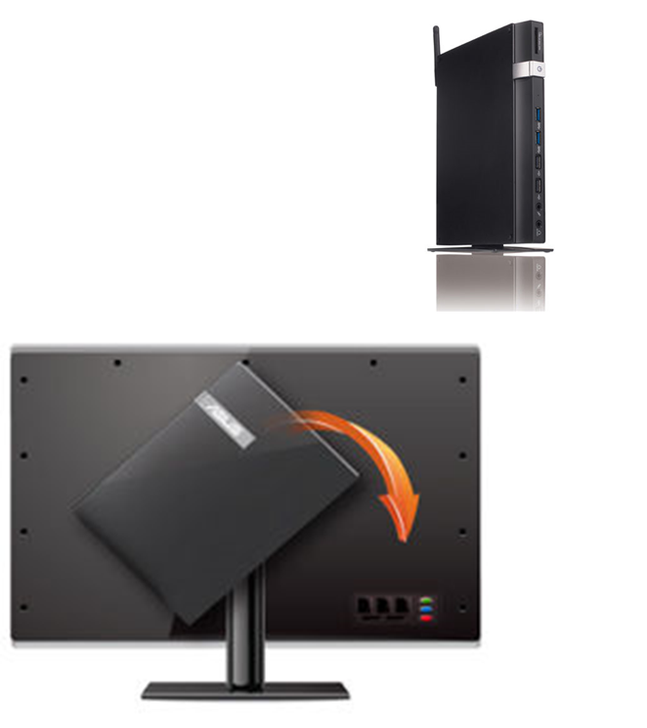
Hardware (not provided by 2Ring)
Screens
  If you plan on using a smart TV, test it using www.2Ring.com/TryIt before purchase. E.g. Samsung sells 5 different generations of smart TVs and the older ones come with unsupported browsers ..
PC / Mini-PC
  Usually connected to
  a large LCD via HDMI, VGA or other type of cable
Raspberry Pi
  Enthusiasts can test our wallboards with Raspberry Pi. Reach
  out to us for tips ..
Intel Compute Sticks
  This is essentially
  a mini PC which connects to the TV and has Windows running on it. With Computer Stick,
  there is no need to use TV remote control, as
  you have a keyboard and mouse on your phone ..

Slide 12


