Slide 1

2Ring Dashboards
& Wallboards .. v8.2
Deliver Personalized Information
to Every Screen
Learn More: www.2Ring.com/DW
A Sample Wallboard Layout: 2Ring.com/TryIt
Full Demo Access: 2Ring.com/DWtrial
Follow Us on Twitter: @2Ring4UC
Follow Us on LinkedIn: www.linkedin.com/company/2Ring
Notes:
Last Update: Feb 24, 2020

Slide 2
Founded in 2001
..

Slide 3

Products available through Cisco’s Global Price List (CCW)

Slide 4








Indirect
Sales Strategy
..
Notes:
Here are some of the 2Ring resellers, but we are ready to work with the resellers of your choice.

Slide 5
Agile Development
..

Slide 6

EMEAR Headquarters
Slovakia, European Union
Development
Support, Installation, & Training

Slide 7

North American Headquarters
Sacramento, CA
North American Based Support, Installation, & Training

Slide 8
Business Case
Stay informed no matter where you are (web-based layouts + flexible alerts)
  Provide real-time information on contact center (CC) performance, even to executives who are not part of the CC (permalinks).
  Receive alerts via email, SMS / text, IM message, or directly in the marquee that’s part of your layout.
Review all important information on one screen (multiple data source)
  Provide agents with additional business relevant information (ERP / CRM Systems)
Break-down stats for different skill-groups, sites, .. (unlimited number of layouts)
  Create special layout for your service desk (Ticketing System)
Show metrics that matter to your users (out of the box + derived calculations)
  Merge data for multiple queues / skill groups into one row / KPI
  Utilize the support for creation of CUSTOM calculations
Support competition among agents
  Create Top 10 or Bottom 10 views
  Show feedback received via 2Ring Feedback Service: www.2Ring.com/Staffino
  Show trends – e.g. number of calls handled over the recent period (e.g. last 4 weeks)
Broadcast messages to a scrolling text marquee
  Sending messages from Cisco Finesse requires 2Ring Gadgets – Enhanced or Premium Bundle: www.2Ring.com/Gadgets

Slide 9
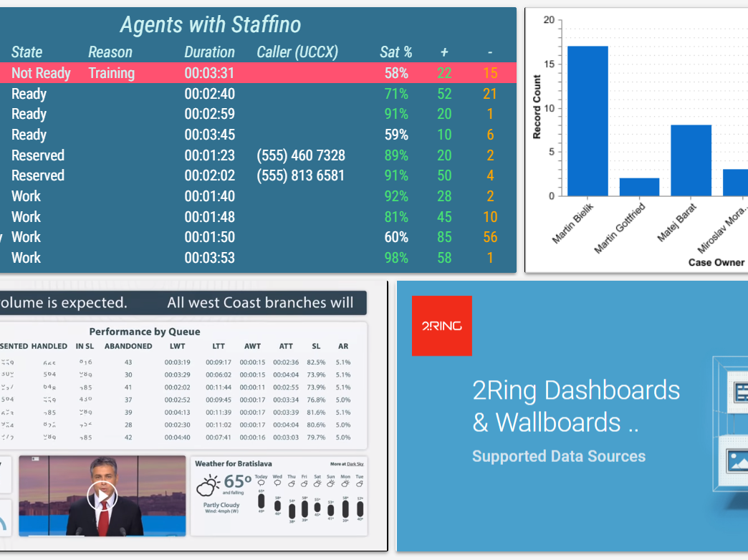
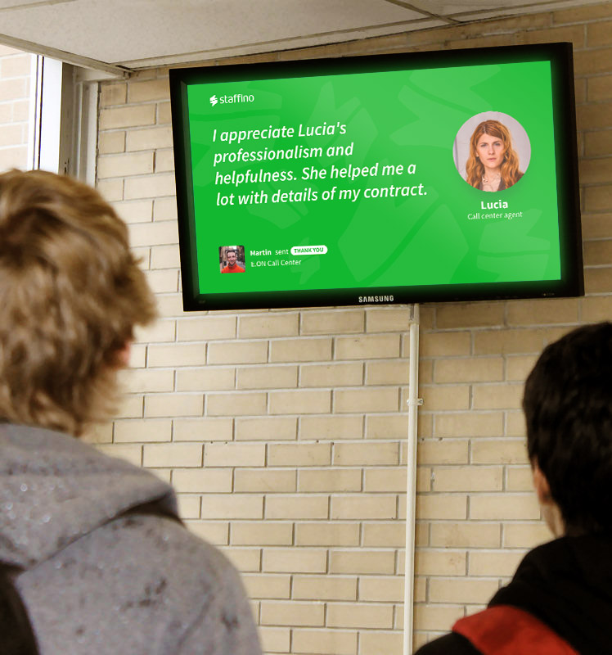
Supported Data Sources
Cisco WebEx Contact Center, incl. Enterprise
Cisco UCCX
Cisco UCCE (incl. Packaged)
Cisco CUCM (CallManager)
Cisco Unity (VoiceMail)
Cisco CUIC Reports
Staffino Customer Feedback
UpstreamWorks
Amazon Connect
Genesys PureCloud and PureEngage
PowerPoint Slides (PDF)
Salesforce (SFDC Dashboard Elements)
ServiceNow (SNOW)
Facebook Feed
Twitter Feed
YouTube Videos and Streams
Weather
Web-Based Content (Anonymous, IFrame)
SQL Data (ad-hoc integrations)
And more to come ..
Notes:
Please contact us for details ..

Slide 10
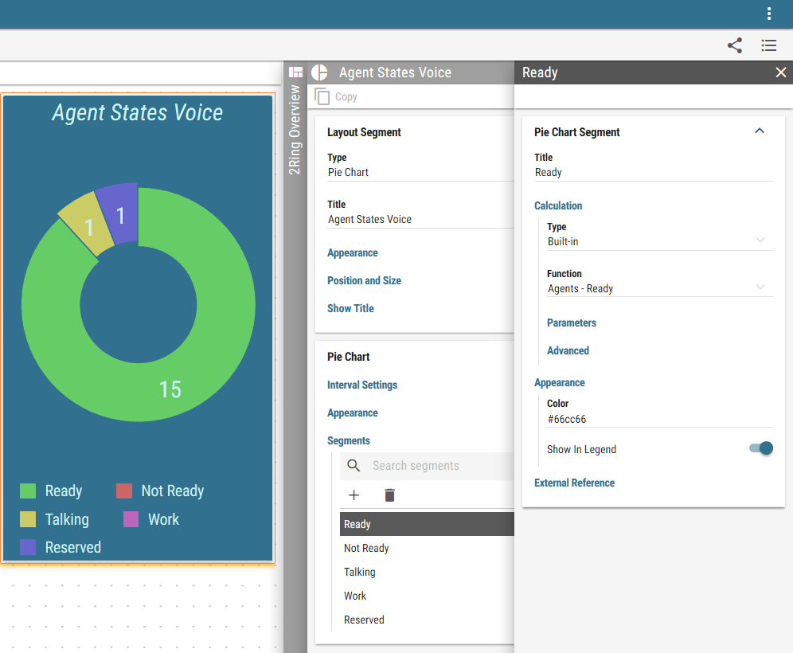
Business User Friendly Configuration Tool
Built-in layout editor (Web-Based)
  Touch-screen friendly with drag & drop support
  All configuration options available via context menus on the right
  Changes applied immediately to the layout’s preview on the left
Layout segments can overlap
Layout parameters
  Layouts can define parameters that are inherited by all KPIs, grids, charts, etc. When value of the parameter changes on the layout, all child source reflect it automatically. For example, select Team or Queue to filter for a specific group easily.
Multi table grids
  A grid can be composed of multiple tables. This allows for combining multiple tables from the same or even from different connectors! For example, a single grid displaying stats from a contact center platfom and from ServiceNow.
Content Picker/Uploader
  Uploading an image or a pdf was never easier. Upload a file directly from the same spot you are asked to pick one from.

Slide 11
2Ring Licensing
Licensing
  Based on the maximum number of concurrent Contact Center agents & supervisors
  Unlimited Wallboard Layouts & Reviewers
Purchase
  As a standalone product or
  As part of “Enhanced Bundle” or “Premium Bundle” of 2Ring GADGETS for Cisco Finesse
Fits everyone
  The solution (and pricing) is ready
  for call centers of all sizes
..

Slide 12
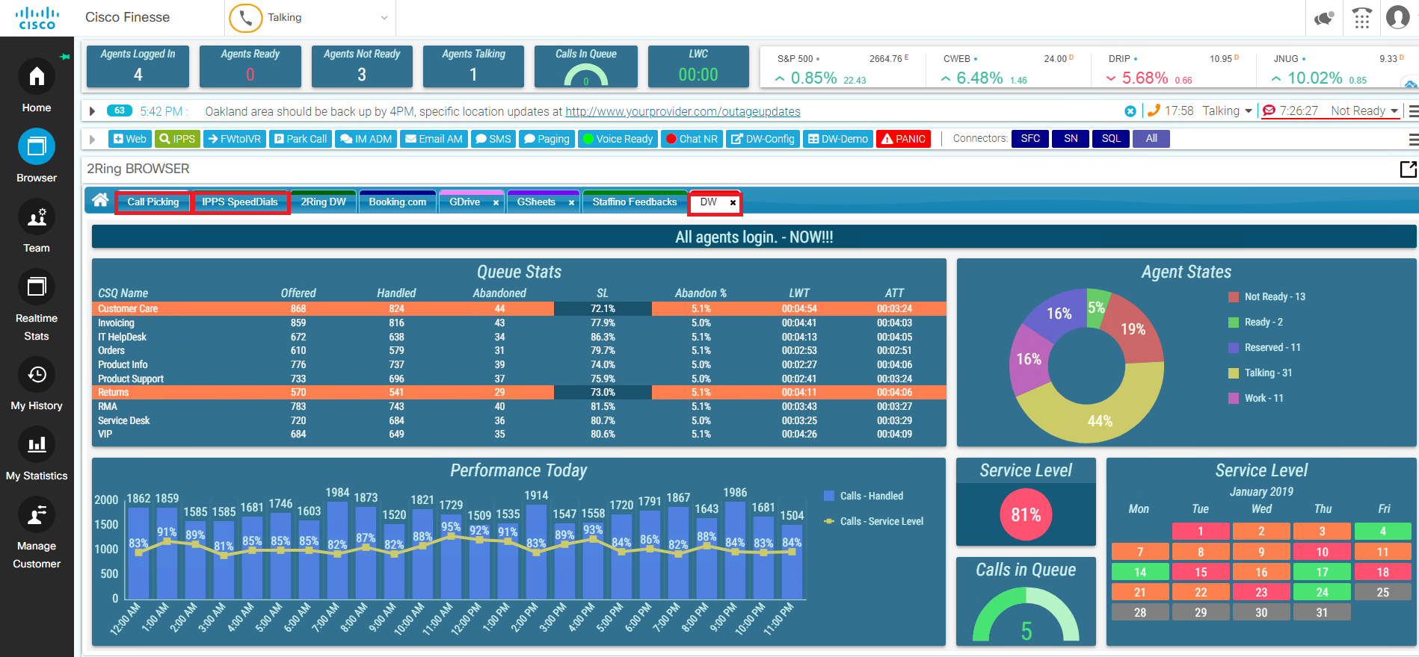
2Ring DW with 2Ring Gadgets for Cisco Finesse

Slide 13
11
Reasons
  Why
  2Ring Dashboards & Wallboards ..
  is
  A W E S O M E
..

Slide 14
1
Multiple Data Sources
..
  Cisco WebExCC (also Enterprise)
  Cisco UCCX
  Cisco UCCE (incl. Packaged)
  Cisco CUCM (CallManager)
  Cisco Unity
  Amazon Connect
  Genesys PureCloud & PureEngage
  UpstreamWorks
  ServiceNow (SNOW)
  Salesforce (Dashboard Elements)
  SQL data sources for ad-hoc integrations other business applications
  Web Content incl. CUIC reports - anonymous, iFrame
  Weather – Current and Forecasts
  Staffino Customer Feedback
  YouTube videos & streams
  PowerPoint Slides – PDF
  And more to come ..

Slide 15
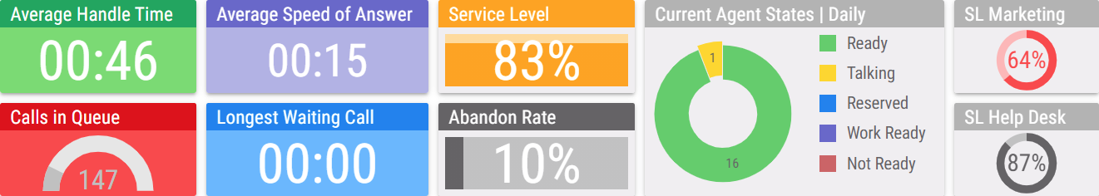
2
Unrivaled number of out-of-the-box KPIs ..
  A long list of ready to use KPIs / Metrics
  plus the option to create derived metrics ..
..

Slide 16
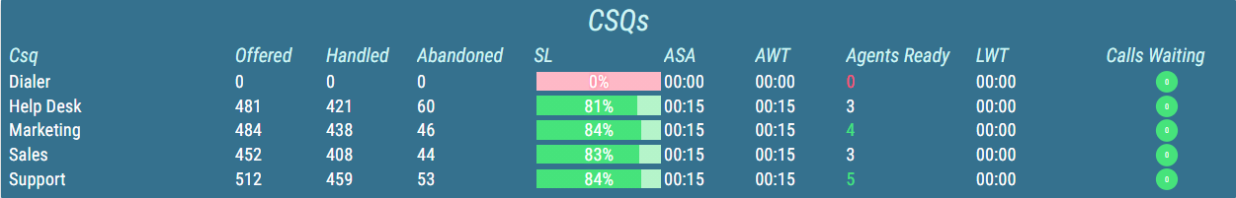
3
  GRIDS for detailed
  Agents or Queue
  statistics in a tabular
  form ..
..

Slide 17
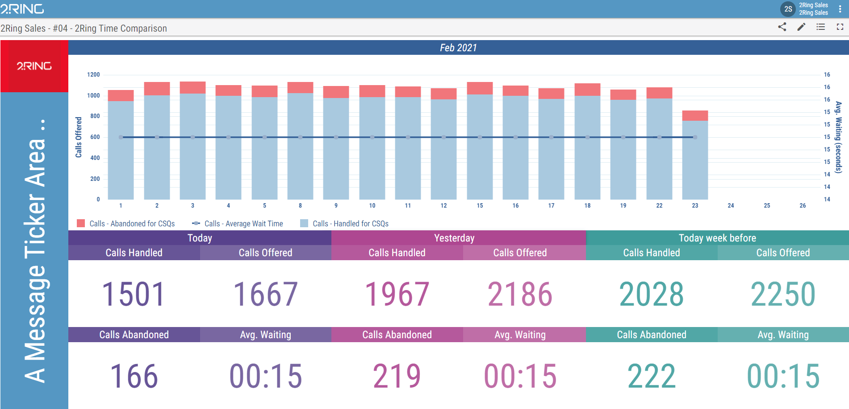
4
..
  Charts for viewing trends and comparing performance over last couple of weeks / months ..

Slide 18
5
E A S I L Y
C R E A T E
  Layouts that YOU can build. Once you change your mind, YOU can make all the necessary updates thanks to a what you see is what you get business user friendly configuration with drag & drop support.. No need to wait for your IT team to be available ..
..

Slide 19
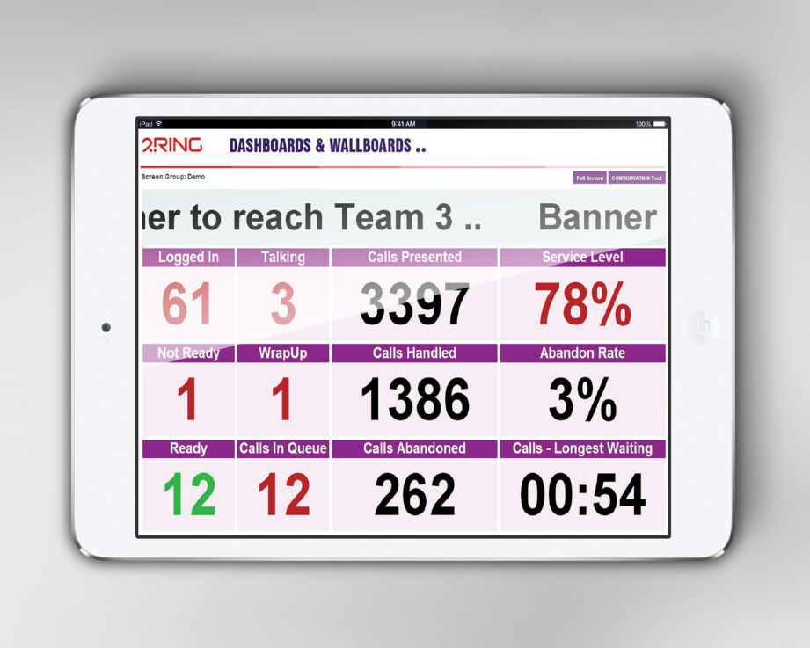
6
HTML5
    Ready for any device with
    a modern
    web browser
    (Chrome, Firefox, Edge, Safari) ..
..

Slide 20
7
U N L I M I T E D
  No limits for # of business units, screens, layouts, devices, sequences .. As long as you can fit your vision on the screen ..
..

Slide 21

8
  CISCO COMPATIBLE
  for UCCX, UCCE (Packaged UCCE) ..
..

Slide 22
9
L I V E
Demo
  Test drive before you buy. All you need is a web browser ..
  Request access to our cloud-based demo at www.2Ring.com/DWtrial
..

Slide 23
10
Support
24x7
  Software Assurance
  for a piece of mind
  for Wallboards
  to work with future
  releases of your Contact Center ..
..

Slide 24
11
A L E R T S
  Set thresholds and receive alerts via channels that you prefer: Email, SMS/text, IM message, ..
..
Supported IM Clients: Cisco WebEx Teams, Microsoft Teams, Discord, and Slack.
Supported Texting Services: Bandwith.com, Red Oxygen, Trumpia, Twillio, and WebText.

Slide 25
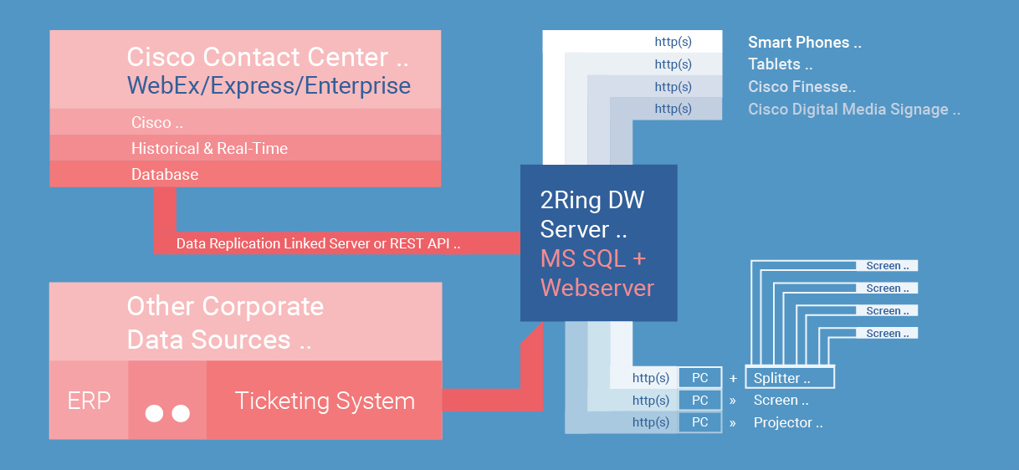
How 2Ring Dashboards & Wallboards (DW) Works

Slide 26
System Requirements
Server
  Microsoft Windows Server 2016 or later
  Microsoft .Net Framework 4.8 or later
  IIS 8.0 or later
  Microsoft SQL Server 2016 (or later) Express Edition (and above)
Azure AD Integration
  Possibly integrated with Azure AD
  Local accounts possible
  Anonymous access links (permalinks) can also be created ..
Workstation / End-User Device
  Modern Web-Browser – Chrome, Edge, Firefox, Safari
  Access to TCP port 80/443 of the 2Ring DW Server

Slide 27
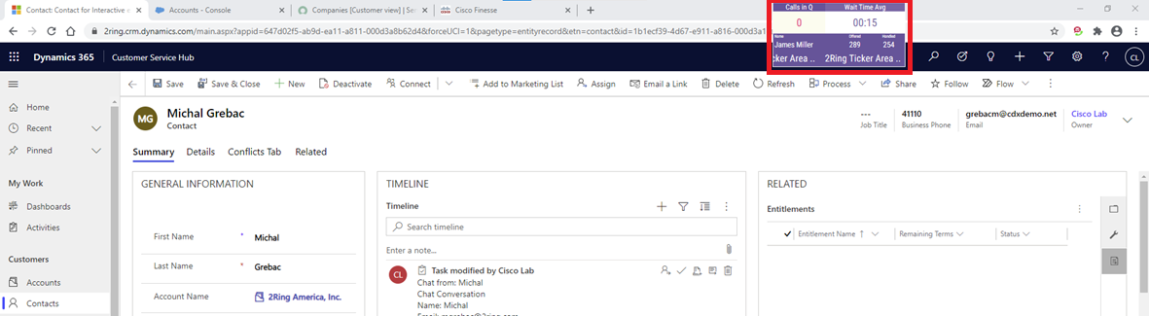
2Ring Power Tool (Personalized Wallboard)
Ability to be always visible on top of all other windows
Flexible window size with embedded layout auto-resizing to the space provided
Personalized grids – build one layout for every agent seeing his/her metrics only
Remembers its position and window size

Slide 28
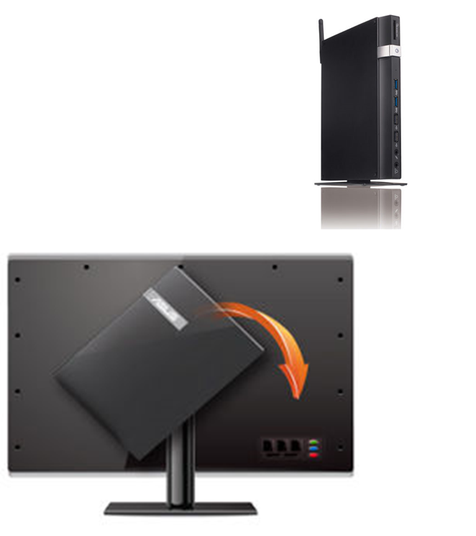
HW for Traditional Screens (not provided by 2Ring)
Screens
  If you plan on using a smart TV, test it using www.2Ring.com/TryIt before purchase. E.g. Samsung sells ~5 different generations of smart TVs and the older ones come with unsupported browsers.
PC / Mini-PC
  Usually connected to
  a large LCD via HDMI, VGA or other type of cable
Raspberry Pi
  Enthusiasts can test our wallboards with Raspberry Pi. Reach
  out to us for tips ..
Intel Compute Sticks
  This is essentially
  a mini PC which connects to the TV and has Windows running on it. With Computer Stick,
  there’s no need to use a TV remote control as
  you have a keyboard and mouse on your phone ..

Slide 29
Want to know more?
Start the conversation today!
  Web: www.2Ring.com/DW
  Free Trial: www.2Ring.com/DWtrial
  Schedule a live demo over Cisco WebEx: www.2Ring.com/WebEx
  Follow us on Twitter: www.2Ring.com/Twitter
  Follow us on LinkedIn: www.2Ring.com/LinkedIn
  Email us:
    info@2Ring.com (EMEAR)
    info-na@2Ring.com (Americas + APAC)

